Slide 1

Parallel MATLAB jobs on Biowulf
Dave Godlove, HPC @ NIH
david.godlove@nih.gov
February 17, 2016
While waiting for the class to begin, log onto Helix and execute the following command
$ cp –r /data/classes/matlab/swarm_example /data/$USER

Slide 2
  Outline
Steps to running parallel MATLAB jobs
  Developing code interactively
  Compiling code
  Writing swarm files and calling swarm
  Monitoring jobs
A concrete example (processing image files)
$ cp –r /data/classes/matlab/swarm_example /data/$USER

Slide 3
  Quick review of a few MATLAB tricks
fprintf
>> name='Mary'; adjective='little'; noun='lamb'
>> fprintf('%s had a %s %s. \n',name,adjective,noun)
Mary had a little lamb.
>>

Slide 4
  Quick review of a few MATLAB tricks
sprintf
>> name='Mary'; adjective='little'; noun='lamb'
>> sentence = ...
sprintf('%s had a %s %s. \n',name,adjective,noun);
>> sentence
sentence =
Mary had a little lamb.

Slide 5
  Quick review of a few MATLAB tricks
eval
>> part1='6'; part2='7';
>> eval(['ultimate_answer = ' part1 ' * ' part2])
ultimate_answer =
42

Slide 6
  Quick review of a few MATLAB tricks
eval(sprintf('command'))
>> part1='6'; part2='7';
>> eval(sprintf('ultimate_answer = %s * %s',part1,part2))
ultimate_answer =
42

Slide 7
  Quick review of a few MATLAB tricks
evalc
>> part1='6'; part2='7';
>> my_string = ...
evalc(sprintf('ultimate_answer = %s * %s',part1,part2));
>> my_string
my_string =
ultimate_answer =
42

Slide 8
  Quick review of a few MATLAB tricks
! (pronounced bang, similar to system)
>> whoami
Undefined function or variable 'whoami'.
>> !whoami
godlovedc
>> user = evalc('!whoami'), host = evalc('!hostname')
user =
godlovedc
host =
cn1653

Slide 9
  Quick review of a few MATLAB tricks
fprintf
sprintf
eval
evalc
!

Slide 10
  Outline
Steps to running parallel MATLAB jobs
  Developing code interactively
  Compiling code
  Writing swarm files and calling swarm
  Monitoring jobs
A concrete example (processing image files)
$ cp –r /data/classes/matlab/swarm_example /data/$USER

Slide 11
  Outline
Steps to running parallel MATLAB jobs
  Developing code interactively
  Compiling code
  Writing swarm files and calling swarm
  Monitoring jobs
A concrete example (processing image files)
$ cp –r /data/classes/matlab/swarm_example /data/$USER
Notes:
The NIH Biowulf Cluster: Scientific Supercomputing
Wed Feb 03
All Day
Steven Fellini/Susan Chacko

Slide 12




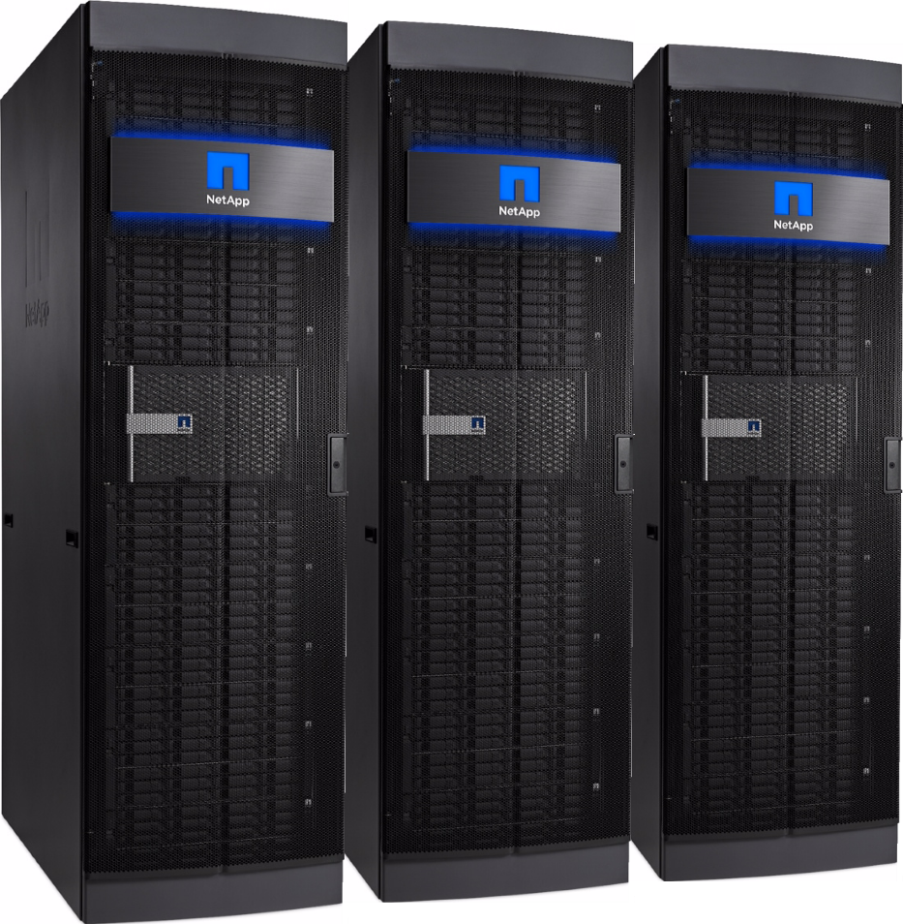

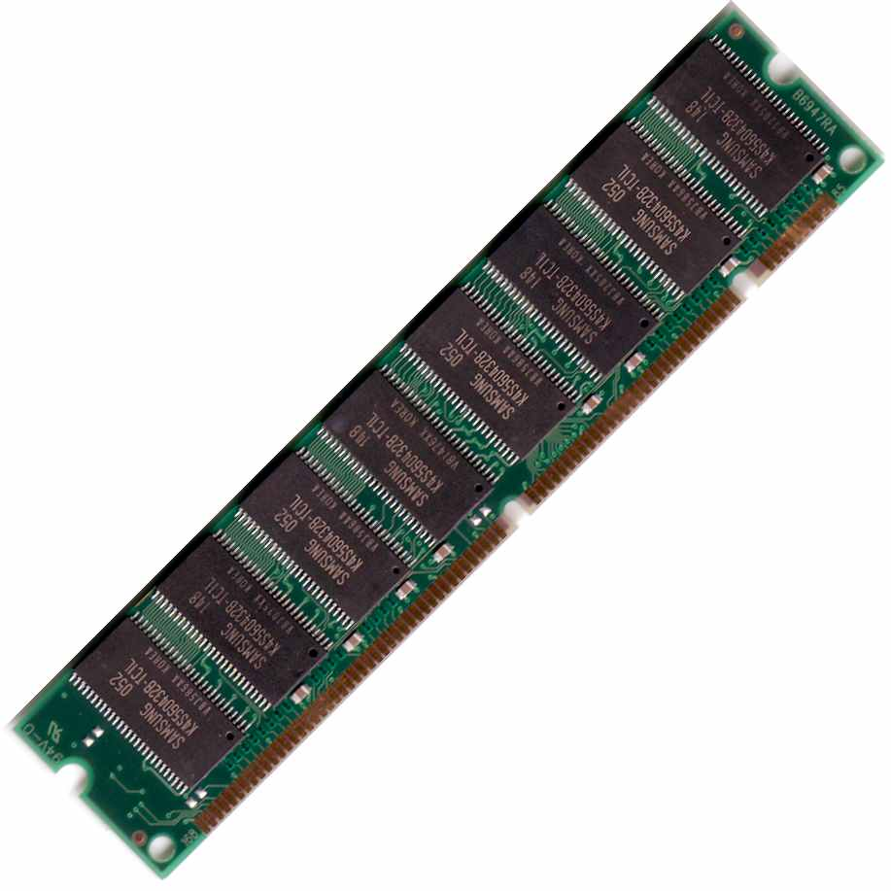
  Quick overview of the cluster
  Storage (mounted on all nodes)
  Biowulf partition
  Biowulf cluster
  Biowulf login node
2 CPUs
(1 hyperthreaded core)
  Biowulf compute node
4 GB memory
(2 GB per CPU)
Notes:
The NIH Biowulf Cluster: Scientific Supercomputing
Wed Feb 03
All Day
Steven Fellini/Susan Chacko

Slide 13
  Developing code interactively
The steps to starting an interactive MATLAB session on a Biowulf compute node
$ ssh -Y user@biowulf.nih.gov
$ sinteractive -c 4 --mem=4g -L matlab,matlab-image,matlab-stat,matlab-compiler
$ module load matlab/<ver>
Two options, GUI or command prompt
$ matlab&
Or
$ matlab -nojvm

Slide 14
  Developing code interactively
Using ssh to start a secure shell session on biowulf
$ ssh -Y user@biowulf.nih.gov
This step my differ depending on the client
-putty
-X-Win32
-XQuartz
-NoMachine (preferred client / available for Windows, Mac and Linux, )
https://hpc.nih.gov/docs/connect.html

Slide 15
  Developing code interactively
Using sinteractive to allocate resources
$ sinteractive -c 4 --mem=4g -L matlab,matlab-image,matlab-stat,matlab-compiler

Slide 16
  Developing code interactively
Loading modules
$ module load matlab
Or
$ module load matlab/2015b
$ module load matlab/2014b
etc...

Slide 17
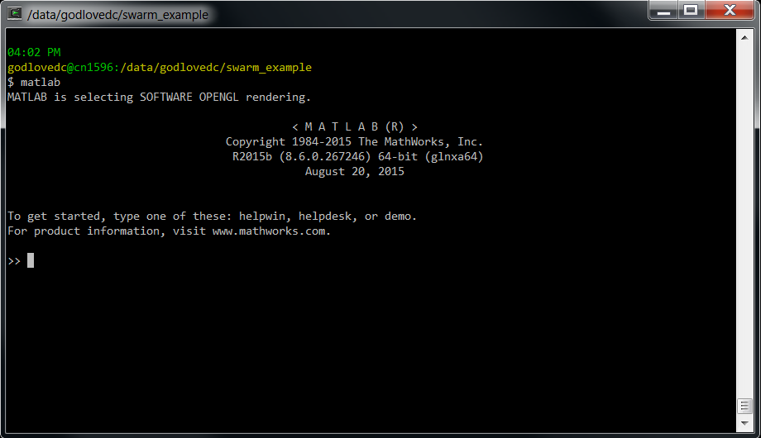
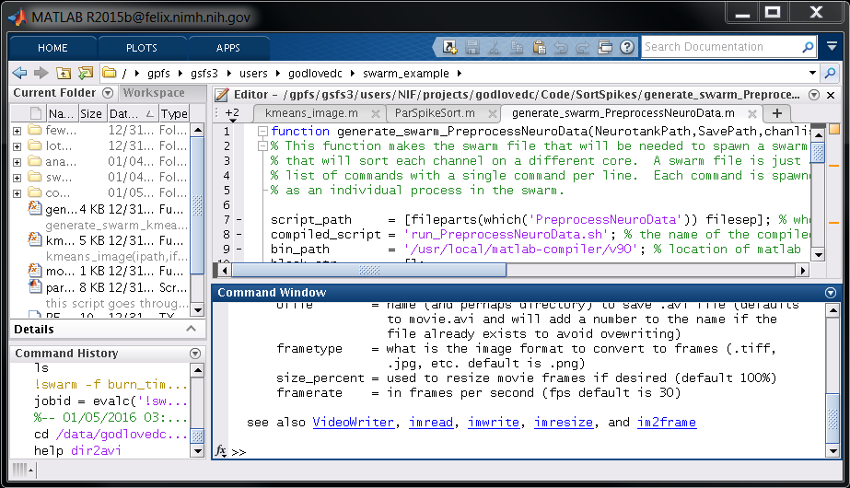
  Developing code interactively
GUI vs. command line MATLAB
$ matlab&
Or
$ matlab -nojvm

Slide 18
  Outline
Steps to running parallel MATLAB jobs
  Developing code interactively
  Compiling code
  Writing swarm files and calling swarm
  Monitoring jobs
A concrete example (processing image files)
$ cp –r /data/classes/matlab/swarm_example /data/$USER

Slide 19
  Outline
Steps to running parallel MATLAB jobs
  Developing code interactively
  Compiling code
  Writing swarm files and calling swarm
  Monitoring jobs
A concrete example (processing image files)
$ cp –r /data/classes/matlab/swarm_example /data/$USER

Slide 20
  Compiling code
Overview
  Removes the need for MATLAB licenses
  Allows you to run hundreds or thousands of instances of your code in parallel

Slide 21
  Compiling code
Overview
  Using a command like the following:
  $ mcc2 –m my_function.m
  or
  >> mcc2 -m my_function.m
  or
  >> mcc2('-m','my_function.m')

Slide 22
  Compiling code
Overview
produces several new files
(from my_function.m)
my_function
run_my_function.sh
readme.txt
mccExcludedFiles.log
requiredMCRProducts.txt
  binary
  shell wrapper used to invoke my_function
  some useful info (version of MATLAB)
  lists some files that cannot be compiled
  not human readable?

Slide 23
  Compiling code
Overview
Execute compiled code using the shell script:
$ run_my_function.sh /usr/local/matlab-compiler/v90 input1 input2 inputN

Slide 24
  Compiling code
Before you begin
  Consider suppressing non-diagnostic output and figures
  Will not be seen by user during execution and may complicate output (.o) files.

Slide 25
  Compiling code
Before you begin
  Can use the isdeployed flag:
    % isdeployed evaluates to “true” if code is
    % compiled here we say if not deployed plot a
    % figure and pause
    if ~isdeployed
      figure
      plot(x,y)
      pause
    end

Slide 26
  Compiling code
Before you begin
  Every function must be on your path at compile time.

Slide 27
  Compiling code
Before you begin
  Every function must be on your path at compile time!
  No addpath('/new/path') statements!
  Avoid cd('/new/path') statements too!

Slide 28
  Compiling code
Before you begin
  Compiled code will only accept strings as input
$ run_my_function.sh /usr/local/matlab-compiler/v90 input1 input2 inputN
For example:
$ run_my_function.sh /usr/local/matlab-compiler/v90 3 [1 2 5] {1,2,5}
Will be interpreted as:
>> my_function('3','[1 2 5]','{1,2,5}')

Slide 29
  Compiling code
Before you begin
  Code must convert strings back to their intended data types
    input1 = char2double(input1);
    eval(sprintf('input1 = %s;',input1))

Slide 30
  Compiling code
Before you begin
  Code must convert strings back to their intended data types
    % this will check to see if the variable (var) is
    % string and will convert it to strings value
    if ischar(input1)
      eval(sprintf('input1 = %s;',input1))
    end

Slide 31
  Compiling code
When ready to compile, mcc is the proper command.
  >> mcc -m my_function.m
  But don’t use it!
  It will tie the compiler license up for as long as your MATLAB session is active!

Slide 32
  Compiling code
Instead, use mcc2 (wrapper to mcc)
  >> mcc2 -m my_function.m
  Opens a new instance of MATLAB, calls mcc to compile code, then closes new instance of MATLAB to release compiler license.
  Available from MATLAB interactive sessions or from the shell (after loading MATLAB module).

Slide 33
  Compiling code
Use the following command if mcc2 does not appear on your search path.
  >> rehash toolbox

Slide 34
  Compiling code
Runtime flags
-singleCompThread
-nodisplay
-nojvm
For example:
>> mcc2 -m -R -nodisplay -R -singleCompThread my_function.m

Slide 35
  Compiling code
Using the correct component runtime
$ run_my_function.sh /usr/local/matlab-compiler/v90 input1 input2 inputN
        MATLAB version runtime library
        -------------- ----------------
        2015b v90
        2015a v85
        2014b v84
        2013a v81
        2012b v80
  More info at:
  https://hpc.nih.gov/apps/Matlab_compiler.html

Slide 36
  Compiling code
Using a local mcr cache
  $ ls -al | grep mcr
  drwxr-x--- 10 godlovedc godlovedc 4096 Nov 10 11:04 .mcrCache8.0
  drwxr-xr-x 6 godlovedc godlovedc 32768 Jan 27 10:51 .mcrCache8.1
  drwxr-x--- 5 godlovedc godlovedc 73728 Jan 27 11:25 .mcrCache8.4
  drwxr-x--- 13 godlovedc godlovedc 8192 Oct 28 12:06 .mcrCache8.5
  drwxr-x--- 14 godlovedc godlovedc 24576 Feb 16 01:28 .mcrCache9.0

Slide 37
  Compiling code
Using a local mcr cache
  $ export MCR_CACHE_ROOT=/tmp/$USER/mcr_cache
  or
  >> user = deblank(evalc('!whoami'));
  >> setenv('MCR_CACHE_ROOT',fullfile('/tmp',user,'mcr_cache'))

Slide 38
  Outline
Steps to running parallel MATLAB jobs
  Developing code interactively
  Compiling code
  Writing swarm files and calling swarm
  Monitoring jobs
A concrete example (processing image files)
$ cp –r /data/classes/matlab/swarm_example /data/$USER

Slide 39
  Outline
Steps to running parallel MATLAB jobs
  Developing code interactively
  Compiling code
  Writing swarm files and calling swarm
  Monitoring jobs
A concrete example (processing image files)
$ cp –r /data/classes/matlab/swarm_example /data/$USER

Slide 40
  Writing swarm files and calling swarm
Swarm is a wrapper for sbatch
Creates 1 job per line (in a job array)
Greatly simplifies job submission
Tons of options
Can capture sbatch commands if useful

Slide 41
  Writing swarm files and calling swarm
Overview: two step process
Write a swarm file that has a single command (job) on each line
Invoke the swarm program using the name of the swarm file as an argument

Slide 42
  Writing swarm files and calling swarm
Example swarm file:
myjobs.swarm
run_my_function.sh /usr/local/matlab-compiler/v90 param1
run_my_function.sh /usr/local/matlab-compiler/v90 param2
run_my_function.sh /usr/local/matlab-compiler/v90 param3
run_my_function.sh /usr/local/matlab-compiler/v90 paramN
$ swarm -f myjobs.swarm

Slide 43
  Writing swarm files and calling swarm
Generating swarm files in MATLAB
% stick all the parameters in an array
param_list = {'param1' 'param2' 'param3' 'paramN'};
% make a command on a new line for each parameter
command_list = [];
for ii = 1:length(param_list)
command_list = [command_list ...
'run_my_function.sh '...
'/usr/local/matlab-compiler/v90 '...
param_list{ii}...
'\n'];
end
% write the commands into a swarm file
file_handle = fopen('myjobs.swarm','w+');
fprintf(file_handle,command_list);
fclose(file_handle);

Slide 44
  Writing swarm files and calling swarm
Example swarm file:
myjobs.swarm
run_my_function.sh /usr/local/matlab-compiler/v90 param1
run_my_function.sh /usr/local/matlab-compiler/v90 param2
run_my_function.sh /usr/local/matlab-compiler/v90 param3
run_my_function.sh /usr/local/matlab-compiler/v90 paramN

Slide 45
  Writing swarm files and calling swarm
Remember:
Inputs are strings
run_my_function.sh /usr/local/matlab-compiler/v90 1
run_my_function.sh /usr/local/matlab-compiler/v90 2
run_my_function.sh /usr/local/matlab-compiler/v90 3
run_my_function.sh /usr/local/matlab-compiler/v90 4

Slide 46
  Writing swarm files and calling swarm
Arrays as input to compiled functions
param1 =
4 1 0 2
4 4 0 5
2 0 4 0
3 1 3 2
>> param1 = ['"' mat2str(param1) '"']
param1 =
"[4 1 0 2;4 4 0 5;2 0 4 0;3 1 3 2]"

Slide 47
  Writing swarm files and calling swarm
Arrays as input to compiled functions
run_my_function.sh /usr/local/matlab-compiler/v90 "[4 1 0 2;4 4 0 5;2 0 4 0;3 1 3 2]"
run_my_function.sh /usr/local/matlab-compiler/v90 "[2 2 4 1;4 2 1 1;4 3 3 2;1 4 3 5]"
run_my_function.sh /usr/local/matlab-compiler/v90 "[2 1 5 1;3 3 3 4;1 3 1 1;4 4 1 4]"
…
run_my_function.sh /usr/local/matlab-compiler/v90 "[1 1 4 1;5 3 3 4;2 2 3 4;1 2 5 2]"

Slide 48
  Writing swarm files and calling swarm
Arrays as input to compiled functions
param1 =
[4 1 0 2;4 4 0 5;2 0 4 0;3 1 3 2]
>> eval(sprintf('param1 = %s',param1))
param1 =
4 1 0 2
4 4 0 5
2 0 4 0
3 1 3 2

Slide 49
  Writing swarm files and calling swarm
Cell arrays as input to compiled functions
>> param1 = {'Bill','Steve','Linus','Cleve'}
param1 =
'Bill' 'Steve' 'Linus' 'Cleve'

Slide 50
  Writing swarm files and calling swarm
Cell arrays as input to compiled functions
param1 = {'Bill','Steve','Linus','Cleve'}
param_str = [];
for ii = 1:length(param1)
param_str = [param_str '''' param1{ii} '''' ','];
end
param1 = ['"{' param_str(1:end-1) '}"'];
>> param1
param1 =
"{'Bill','Steve','Linus','Cleve'}"

Slide 51
  Writing swarm files and calling swarm
Cell arrays as input to compiled functions
run_my_function.sh /usr/local/matlab-compiler/v90 "{'Bill','Steve','Linus','Cleve'}"
run_my_function.sh /usr/local/matlab-compiler/v90 "{'Hank','Dean','Doc','Brock'}"
run_my_function.sh /usr/local/matlab-compiler/v90 "{'Sheila','Triana','Kim','Sally'}"
…
run_my_function.sh /usr/local/matlab-compiler/v90 "{'Walt','Jesse','Gus','Mike'}"

Slide 52
  Writing swarm files and calling swarm
Cell arrays as input to compiled functions
param1 =
{'Bill','Steve','Linus','Cleve'}
>> eval(sprintf('param1 = %s',param1))
param1 =
'Bill' 'Steve' 'Linus' 'Cleve'

Slide 53
  Writing swarm files and calling swarm
.mat files as input
>> param = round(rand(4)*10)
param =
4 1 0 2
4 4 0 5
2 0 4 0
3 1 3 2

Slide 54
  Writing swarm files and calling swarm
.mat files as input
% how many files?
fileN = 4;
% make a directory for .mat files
mat_dir = '~/mat_dir';
if ~isdir(mat_dir)
mkdir(mat_dir)
end
% generate arrays and save in .mat files
for ii = 1:fileN
param = round(rand(4)*10);
filename = sprintf('%s.mat',num2str(ii));
save(fullfile(mat_dir,filename),'param');
end

Slide 55
  Writing swarm files and calling swarm
% list all the files in a directory
mat_dir = '~/mat_dir';
file_list = what(mat_dir);
file_list = file_list.mat;
% make a command on a new line for each file
command_list = [];
for ii = 1:length(file_list)
command_list = [command_list ...
'run_my_function.sh '...
'/usr/local/matlab-comiler/v90 '...
file_list{ii}...
'\n'];
end
% write the commands into a swarm file
file_handle = fopen('myjobs.swarm','w+');
fprintf(file_handle,command_list);
fclose(file_handle);

Slide 56
  Writing swarm files and calling swarm
.mat files as input
run_my_function.sh /usr/local/matlab-compiler/v90 1.mat
run_my_function.sh /usr/local/matlab-compiler/v90 2.mat
run_my_function.sh /usr/local/matlab-compiler/v90 3.mat
run_my_function.sh /usr/local/matlab-compiler/v90 4.mat

Slide 57
  Writing swarm files and calling swarm
.mat files as input
function my_function(filename)
load(filename,'param')
% param =
% 4 1 0 2
% 4 4 0 5
% 2 0 4 0
% 3 1 3 2
% code that uses input1 below...
% ...

Slide 58
  Writing swarm files and calling swarm
Calling swarm to run file in terminal
$ swarm -f myjobs.swarm
10258332
From within MATLAB
>> !swarm -f myjobs.swarm
10258333

Slide 59
  Writing swarm files and calling swarm
Even better from within MATLAB (capture the job id)!
>> jobid = evalc('!swarm -f myjobs.swarm')
jobid =
10259035

Slide 60
  Writing swarm files and calling swarm
Setting up dependencies with job ids
$ swarm -f myjobs.swarm
10258332
$ swarm -f anotherjob.swarm -dependency=afterany:10258332

Slide 61
  Writing swarm files and calling swarm
Setting up dynamic dependencies with captured
job ids in MATLAB
>> jobid = evalc('!swarm -f myjobs.swarm');
>> eval(sprintf('!swarm -f anotherjob.swarm dependency=afterany:%s',...
jobid))
10258333

Slide 62
  Writing swarm files and calling swarm
Setting up dynamic dependencies with captured
job ids in MATLAB
>> jobid = evalc('!swarm -f job1.swarm');
>> jobid = evalc(sprintf('!swarm -f job2.swarm dependency=afterany:%s',...
jobid));
>> jobid = evalc(sprintf('!swarm -f job3.swarm dependency=afterany:%s',...
jobid));
>> jobid = evalc(sprintf('!swarm -f jobN.swarm dependency=afterany:%s',...
jobid));
Etc…

Slide 63
  Outline
Steps to running parallel MATLAB jobs
  Developing code interactively
  Compiling code
  Writing swarm files and calling swarm
  Monitoring jobs
A concrete example (processing image files)
$ cp –r /data/classes/matlab/swarm_example /data/$USER

Slide 64
  Outline
Steps to running parallel MATLAB jobs
  Developing code interactively
  Compiling code
  Writing swarm files and calling swarm
  Monitoring jobs
A concrete example (processing image files)
$ cp –r /data/classes/matlab/swarm_example /data/$USER

Slide 65
  Monitoring jobs
$ squeue -j 10258333
$ squeue -u username
$ jobload -j 10258333
$ jobload -u username
$ sjobs -j 10258333
$ sjobs -u username
$ jobhist jobid

Slide 66
  Monitoring jobs dynamically
>> eval(sprintf('!squeue -j %s',jobid))
>> eval('!squeue $USER')
>> eval(sprintf('!jobload -j %s',jobid))
>> eval('!jobload $USER')
>> eval(sprintf('!sjobs -j %s',jobid))
>> eval('!sjobs $USER')
>> eval(sprintf('!jobhist %s',jobid))

Slide 67
  Monitoring jobs
myjobs.o
myjobs.e

Slide 68

  Time for a break

