Slide 1
High-Performance Computing with RELION
David Hoover, PhD
HPC @ NIH

Slide 2

Biowulf Seminar Series
Sagar Chittori LCB, NCI
Cryo-EM studies of glutamate receptors and nucleosomes
Wed May 09, 2018, 11 am – noon
Bldg 50, Rm 1227 (next to the coffeshop)
TOMORROW ONLY!

Slide 3
Brief Overview of RELION
Purify macromolecules and freeze onto platform
Collect TEM images (2D projections)
Clean up images (defocus, tilt, motion, blur)
Isolate individual particle projection images
Classify particles
Predict original orientation, maximum likelihood
Refine prediction with “smooth” maps
Polish particles to improve signal-to-noise

Slide 4
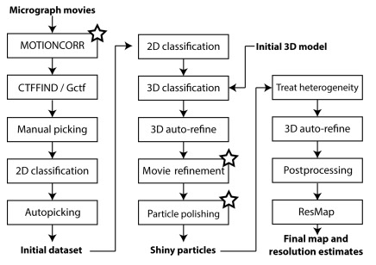
Brief Overview of RELION
Scheres, S.H.W. Meth. Enzy. 579, 2016

Slide 5
Brief Overview of RELION
Many steps can be parallelized
A few steps can be accelerated using GPUs

Slide 6
Cluster and Hardware Overview

Slide 7
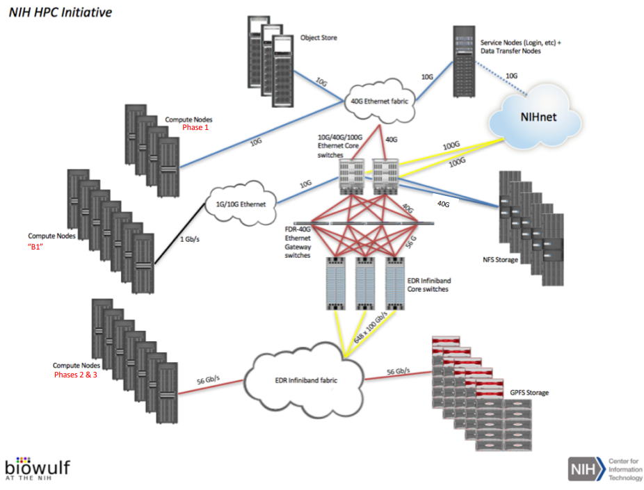
Biowulf Cluster Overview

Slide 8
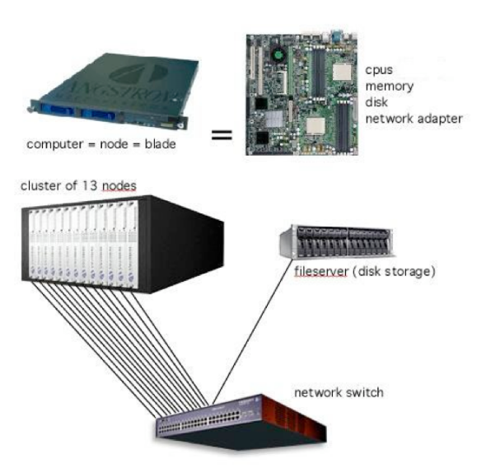
Biowulf Cluster Overview

Slide 9
Node Anatomy
CPU (real)
CPU (virtual)
node
core
0
28
1
29
2
30
3
31
memory
4
32
5
33
6
34
7
35
8
36
9
37
10
38
11
39
12
40
13
41
14
42
15
43
16
44
17
45
18
46
19
47
20
48
21
49
22
50
23
51
lscratch
24
52
25
53
26
54
27
55
0
1
2
3
GPUs

Slide 10
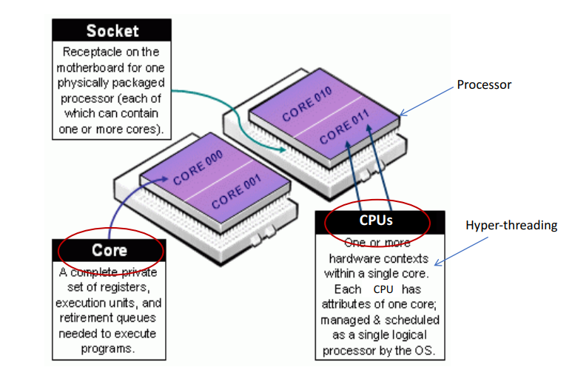
Processor Hardware

Slide 11
Parallelization on the Biowulf Cluster

Slide 12

Parallelization on Biowulf using Slurm
Allocation of resources
Distribution of resources
Distribution of tasks on the allocated and distributed resources

Slide 13

Multi-user Time-sharing Batch System

Slide 14
Single-Threaded Job
Slurm allocates in units of cores, not CPUs
0
28
1
29
2
30
3
31
task
4
32
5
33
6
34
7
35
8
36
9
37
10
38
11
39
12
40
13
41
14
42
15
43
16
44
17
45
18
46
19
47
(--ntasks=1)
(--cpus-per-task=2)
20
48
21
49
22
50
23
51
24
52
25
53
26
54
27
55
sbatch
sinteractive
executable arg arg arg …
executable arg arg arg …

Slide 15
Multi-threaded Job
task
0
28
1
29
2
30
3
31
4
32
5
33
6
34
7
35
8
36
9
37
10
38
11
39
12
40
13
41
14
42
15
43
16
44
17
45
18
46
19
47
(--ntasks=1 implied)
20
48
21
49
22
50
23
51
24
52
25
53
26
54
27
55
sbatch --cpus-per-task=16
executable -p $SLURM_CPUS_PER_TASK arg arg arg …
sinteractive --cpus-per-task=16
executable -p $SLURM_CPUS_PER_TASK arg arg arg …

Slide 16
MPI Job: single node
0
28
1
29
2
30
3
31
4
32
5
33
6
34
7
35
8
36
9
37
10
38
11
39
12
40
13
41
14
42
15
43
16
44
17
45
18
46
19
47
20
48
21
49
22
50
23
51
24
52
25
53
26
54
27
55
sbatch --ntasks=8 --nodes=1
sinteractive --ntasks=8 --nodes=1
srun --mpi=pmi2 executable arg arg arg …
mpirun executable arg arg arg …
launcher

Slide 17
Multi-threaded MPI Job: single node
0
28
1
29
2
30
3
31
4
32
5
33
6
34
7
35
8
36
9
37
10
38
11
39
12
40
13
41
14
42
15
43
16
44
17
45
18
46
19
47
20
48
21
49
22
50
23
51
24
52
25
53
26
54
27
55
sbatch --ntasks=8 --nodes=1 --cpus-per-task=2
srun --mpi=pmi2 executable -p $SLURM_CPUS_PER_TASK arg arg arg …
sinteractive --ntasks=8 --nodes=1 --cpus-per-task=2
mpirun executable -p $SLURM_CPUS_PER_TASK arg arg arg …

Slide 18
Multi-threaded MPI Job: multiple nodes
node1
node2
node3
node4
sbatch --cpus-per-task=8 --ntasks=8 --partition=multinode
srun --mpi=pmi2 executable -p $SLURM_CPUS_PER_TASK arg arg arg …
sinteractive --cpus-per-task=8 --ntasks=8 --partition=multinode
mpirun executable -p $SLURM_CPUS_PER_TASK arg arg arg …

Slide 19
Slurm Resources

Slide 20
Memory: Single-threaded Job
4 GB
1.5 GB
0
28
1
29
2
30
3
31
task
4
32
5
33
6
34
7
35
8
36
9
37
10
38
11
39
12
40
13
41
14
42
15
43
16
44
17
45
18
46
19
47
20
48
21
49
22
50
23
51
24
52
25
53
26
54
27
55
sbatch
sinteractive
(--mem-per-cpu=2g)
(--mem-per-cpu=768)

Slide 21
Memory: Multi-threaded Job
32 GB
12 GB
task
0
28
1
29
2
30
3
31
4
32
5
33
6
34
7
35
8
36
9
37
10
38
11
39
shared among all threads
12
40
13
41
14
42
15
43
16
44
17
45
18
46
19
47
20
48
21
49
22
50
23
51
24
52
25
53
26
54
27
55
(--mem-per-cpu=2g)
(--mem-per-cpu=768)
sbatch --cpus-per-task=16
sinteractive --cpus-per-task=16

Slide 22
Memory: MPI Job
32 GB
0
28
1
29
2
30
3
31
4
32
5
33
6
34
7
35
8
36
9
37
10
38
11
39
12
40
13
41
14
42
15
43
16
44
17
45
18
46
19
47
20
48
21
49
22
50
23
51
24
52
25
53
26
54
27
55
sbatch --ntasks=8 --nodes=1 --cpus-per-task=2 --mem-per-cpu=2g
$SLURM_MEM_PER_CPU=2048
sbatch --ntasks=8 --nodes=1 --cpus-per-task=2 --mem=32g
$SLURM_MEM_PER_NODE=32768

Slide 23
Local Scratch: Single Node
Allocated per node
Available to all tasks
0
28
1
29
2
30
3
31
4
32
5
33
6
34
7
35
8
36
9
37
10
38
11
39
12
40
13
41
14
42
15
43
16
44
17
45
18
46
19
47
lscratch
100 GB
20
48
21
49
22
50
23
51
24
52
25
53
26
54
27
55
sbatch --cpus-per-task=2 --ntasks=8 --gres=lscratch:100
/lscratch/$SLURM_JOB_ID

Slide 24
Local Scratch: Multiple Nodes
node1
node2
lscratch
100 GB
lscratch
100 GB
sbatch --ntasks=8 --nodes=4 --cpus-per-task=8 --gres=lscratch:100 --ntasks-per-node=4
node3
node4
lscratch
100 GB
lscratch
100 GB

Slide 25
GPUs
Allocated per node
Accesible to all tasks
0
28
1
29
2
30
3
31
4
32
5
33
6
34
7
35
8
36
9
37
10
38
11
39
12
40
13
41
14
42
15
43
16
44
17
45
18
46
19
47
20
48
21
49
22
50
23
51
24
52
25
53
26
54
27
55
1
2
sbatch --ntasks=8 --nodes=1 --cpus-per-task=2 --gres=gpu:p100:2
CUDA_VISIBLE_DEVICES=1,2

Slide 26
GPU Resource Types
k20x: NVIDIA Kepler 20 (10 GB VRAM, 2x PN)
k80: Kepler 80 (12 GB VRAM, 4x PN)
p100: Pascal 100 (16 GB VRAM, 4x PN)
--gres=gpu:GPUtype:NGPU

Slide 27
Time
Time is a resource – don’t waste it!
Default depends on partition
sbatch --time=60
sbatch --time=4:00:00
sbatch --time=2-00:00:00

Slide 28
MPI Job: Distribution
No guarantee of task placement
node1
node2
node3
node4
sbatch --ntasks=8 --cpus-per-task=8

Slide 29
MPI Job: Distribution
“Egalitarian”, “even” or “flat” distribution
node1
node2
node3
node4
sbatch --ntasks=8 --cpus-per-task=8 --ntasks-per-node=2

Slide 30
MPI Job: Distribution
arbitrary distribution
node1
node2
node3
node4
sbatch --ntasks=8 --cpus-per-task=8 --ntasks-per-node=2
--distribution=arbitrary
file:
node1
node1
node1
node2
node2
node3
node3
node4
node4
export SLURM_HOSTFILE=file
unset SLURM_NTASKS_PER_NODE

Slide 31
Other Resources
Network type (ethernet vs. infiniband)
Processor type (x2680, x2695, x2650)

Slide 32
RELION Run Methods

Slide 33
There are four options
--no_parallel_disc_io
--preread_images
--scratch_dir=directory path
--dont_combine_weights_via_disc

Slide 34
--no_parallel_disc_io
Giving this option causes master process to do all the reading and writing
Don’t set this

Slide 35
--preread_images
Giving this option causes all MPI processes to read particle and image data into memory
Requires quite a bit of memory
About the same speed as local scratch
number of particles * box_size * box_size * 4 / (1024 * 1024 * 1024)

Slide 36
--scratch_dir=directory path
Giving this option causes a single process per node to copy micrographs to local scratch directory
--scratch_dir=/lscratch/$SLURM_JOB_ID
Usually takes less time than --preread_images to get started
In general total runtime is about the same

Slide 37
--dont_combine_weights_via_disc
If this option is NOT given, then after each iteration temporary files will be written to the work directory
Total waste of time and I/O, unless you are debugging the program
Always give this option

Slide 38
RELION Job Types

Slide 39
There are 5 Job Types
Non-MPI, single-threaded, CPU-only
Flat MPI, single-threaded, CPU-only
Flat MPI, single-threaded, CPU + GPU (MotionCor2)
Master-slave MPI, multi-threaded, CPU-only
Master-slave MPI, multi-threaded, CPU + GPU

Slide 40
Single-threaded, no worries
#!/bin/bash
#SBATCH --partition=norm
#SBATCH --mem-per-cpu=8g
#SBATCH --error=Sort/job012/run.err
#SBATCH --output=Sort/job012/run.out
#SBATCH --time=60
module load RELION
relion_particle_sort --i ./Extract/job011/particles.star --ref ./Select/job007/class_averages.star \
--o Sort/job012/particles_sort.star --ctf

Slide 41
RELION Parallelization
Always done with MPI
A few types use flat, single-threaded MPI (CTFFIND, particle sorting, MotionCor2)
The rest use both MPI and pthreads (hybrid-parallel)
Master-Slave method for hybrid-parallel
Master = MPI rank 0, all others are slaves

Slide 42
Flat MPI, CPU-only: CTFFIND4
#!/bin/bash
#SBATCH --ntasks=64
#SBATCH --partition=multinode
#SBATCH --cpus-per-task=1
#SBATCH --error=CtfFind/job003/run.err
#SBATCH --output=CtfFind/job003/run.out
#SBATCH --time=240
#SBATCH --mem-per-cpu=8g
module load RELION
srun --mem-per-cpu=8g --mpi=pmi2 relion_run_ctffind_mpi \
--i MotionCorr/job002/corrected_micrographs.star --o CtfFind/job003/ \
--CS 2 --HT 300 --AmpCnst 0.1 --XMAG 10000 --DStep 3.54 --Box 512 --ResMin 30 --ResMax 7.1 \
--dFMin 5000 --dFMax 50000 --FStep 500 --dAst 100 --use_noDW \
--ctffind_exe $RELION_CTFFIND_EXECUTABLE --ctfWin -1 --is_ctffind4 --only_do_unfinished
Flat, unfixed distribution of 64 tasks with 1 CPU per task, unknown number of nodes,
memory allocated per CPU

Slide 43
Flat MPI, CPU-only
node1
node2
Flat, unfixed distribution of 64 tasks with 1 CPU per task, unknown number of nodes,
memory allocated per CPU

Slide 44
Flat MPI, CPU+GPU: MotionCorr2
#!/bin/bash
#SBATCH --ntasks=8
#SBATCH --partition=gpu
#SBATCH --cpus-per-task=1
#SBATCH --error=MotionCorr/job002/run.err
#SBATCH --output=MotionCorr/job002/run.out
#SBATCH --time=240
#SBATCH --mem=10g
#SBATCH --gres=gpu:p100:4
#SBATCH --nodes=2
#SBATCH --ntasks-per-node=4
module load RELION
srun --mem-per-cpu=8g --mpi=pmi2 relion_run_motioncorr_mpi --i ./Import/job001/movies.star \
--o MotionCorr/job002/ --save_movies --first_frame_sum 1 --last_frame_sum 16 \
--use_motioncor2 --bin_factor 1 --motioncor2_exe $RELION_MOTIONCOR2_EXECUTABLE \
--bfactor 150 --angpix 3.54 --patch_x 5 --patch_y 5 --gpu "" --dose_weighting \
--voltage 300 --dose_per_frame 1 --preexposure 0 --only_do_unfinished
Flat, fixed distribution of 8 tasks on 2 GPU nodes, 4 CPUs and 4 GPUs each node, memory allocated per node, GPUs unassigned

Slide 45
Flat MPI, CPU+GPU: MotionCorr2
node1
node2
0
1
2
3
0
1
2
3

Slide 46
Flat MPI, CPU+GPU: MotionCorr2
node1
node2
0
1
2
3
0
1
2
3

Slide 47
Master-Slave CPU-only: 2D Classification
#!/bin/bash
#SBATCH --gres=lscratch:200
#SBATCH --partition=multinode
#SBATCH --ntasks=513
#SBATCH --cpus-per-task=2
#SBATCH --mem-per-cpu=8g
#SBATCH --error=Class2D/job004/run.err
#SBATCH --output=Class2D/job004/run.out
#SBATCH --time=2-00:00:00
source restrict_tcp_for_mpi.sh
srun --mpi=pmi2 relion_refine_mpi --o Class2D/job004/run --i Particles/shiny_2sets.star
--dont_combine_weights_via_disc --scratch_dir=/lscratch/$SLURM_JOB_ID --pool 100 --ctf --iter 25
--tau2_fudge 2 --particle_diameter 360 --K 200 --flatten_solvent --zero_mask --oversampling 1
--psi_step 6 --offset_range 5 --offset_step 2 --norm --scale --j 2

Slide 48
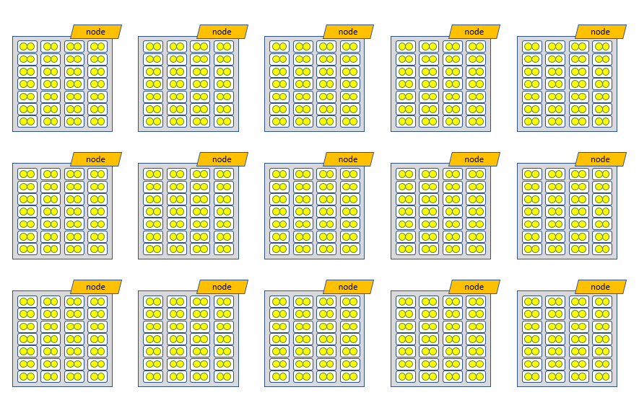
Master-Slave CPU-only: 2D Classification
This is a BIG job… likely about 50 nodes

Slide 49
Master-Slave CPU-only: 2D Classification – all in memory
#!/bin/bash
#SBATCH --partition=multinode
#SBATCH --ntasks=64
#SBATCH --cpus-per-task=16
#SBATCH --mem-per-cpu=15g
#SBATCH --ntasks-per-node=1
#SBATCH --error=Class2D/job011/run.err
#SBATCH --output=Class2D/job011/run.out
#SBATCH --time=2-00:00:00
source restrict_tcp_for_mpi.sh
srun --mpi=pmi2 relion_refine_mpi --o Class2D/job011/run --i Particles/shiny_2sets.star
--dont_combine_weights_via_disc --preread_images --pool 100 --ctf --iter 25 --tau2_fudge 2
--particle_diameter 360 --K 200 --flatten_solvent --zero_mask --oversampling 1 --psi_step 6
--offset_range 5 --offset_step 2 --norm --scale --j 16
Memory is shared among threads
Time required to read into memory can be substantial (hours?)
Not always true that --preread_images is faster that --scratch_dir

Slide 50
Tidbits
RELION does not scale much beyond 2000 CPUs
It takes a LONG time to read images into memory of every single MPI rank
50GB images took ~60 minutes to read into memory for ~500 ranks

Slide 51
Understanding GPU Jobs

Slide 52
Understanding GPU Jobs
GPUs accelerate particular execution steps 80x-100x
Master – Slave model of parallelization conflicts with Slurm resource allocation and MPI rank distribution for GPU nodes
GPU devices mapped to slaves on the basis of MPI rank id and device id

Slide 53
MPI rank - GPU Mapping
Default --gpu ""
GPUs are mapped to MPI ranks in order across ALL MPI ranks, not just those on a node
You could set --gpu manually, but good luck, stockpile aspirin
--gpu 0,0,0,0:1,1,1,1:2,2,2,2:3,3,3,3

Slide 54
Class2D, Class3D, Refine – Problems
sbatch
--cpus-per-task=4
--ntasks=16
--ntasks-per-node=4
--mem=240g
--partition=gpu
--gres=gpu:k80:4,lscratch:100
--constraint=gpuk80
master
node1
node2
node3
node4
1
2
3
4
5
6
7
8
9
10
11
12
13
14
15
0
1
2
3
0
1
2
3
0
1
2
3
0
1
2
3
Why waste GPU when it is worth 80-100 CPUs?

Slide 55
Class2D, Class3D, Refine – Problems
sbatch
--cpus-per-task=4
--ntasks=17
--ntasks-per-node=4
not possible due to GPU limit (16 per job)
sbatch
--cpus-per-task=4
--ntasks=17
--nodes=4
random distribution of tasks on nodes
sbatch
--cpus-per-task=4
--ntasks=17
--nodes=4
--distribution=plane=1
complete overutilization of GPUs
sbatch
--cpus-per-task=4
--ntasks=17
--nodes=4
--mincpus=16
unpredictable which node receives 5 tasks

Slide 56
Arbitrary Distribution
Over allocate on purpose
Create $SLURM_HOSTFILE and unset $SLURM_NTASKS_PER_NODE
$SLURM_HOSTFILE
cn4000
cn4000
cn4000
cn4000
cn4000
cn4001
cn4001
cn4001
cn4001
cn4002
cn4002
cn4002
cn4002
cn4003
cn4003
cn4003
cn4003
sbatch
--cpus-per-task=4
--ntasks=20
--nodes=4
--ntasks-per-node=5
--distribution=arbitrary
array=( $( scontrol show hostname $SLURM_JOB_NODELIST) )
file=$(mktemp)
echo ${array[0]} > $file
for ((i=0;i<${SLURM_JOB_NUM_NODES};i++)); do
for ((j=0;j<$((SLURM_NTASKS_PER_NODE-1));j++)); do
echo ${array[${i}]} >> $file
done
done
export SLURM_HOSTFILE=$file
unset SLURM_NTASKS_PER_NODE

Slide 57
RELION Utility Script
#!/bin/bash
#SBATCH --partition=gpu
#SBATCH --ntasks=20
#SBATCH --cpus-per-task=4
#SBATCH --mem-per-cpu=30g
#SBATCH --ntasks-per-node=5
#SBATCH --nodes=4
#SBATCH --gres=gpu:p100:4,lscratch:200
#SBATCH --distribution=arbitrary
#SBATCH --error=Class2D/job011/run.err
#SBATCH --output=Class2D/job011/run.out
#SBATCH --time=2-00:00:00
source restrict_tcp_for_mpi.sh
source add_extra_MPI_task.sh
srun --mpi=pmi2 relion_refine_mpi --o Class2D/job011/run --i Particles/shiny_2sets.star
--dont_combine_weights_via_disc –scratch_dir=/lscratch/$SLURM_JOB_ID --pool 100
--ctf --iter 25 --tau2_fudge 2 --particle_diameter 360 --K 200 --flatten_solvent --zero_mask
--oversampling 1 --psi_step 6 --offset_range 5 --offset_step 2 --norm --scale --j 4 --gpu “”

Slide 58
Class2D, Class3D, Refine
node1
node2
node3
node4
2
3
4
5
6
7
8
9
10
11
12
13
14
15
16
1
0
1
2
3
0
1
2
3
0
1
2
3
0
1
2
3

Slide 59
Tidbits
Oversubscription of GPUs generally NOT a good idea
Maintain 1 MPI rank per GPU, but 4 or 8 threads per GPU not always bad
The more GPUs, the faster (to a point…)
Run like Goldilocks

Slide 60
GPUs are not constantly used, and all steps not parallelizable
Noise estimation, parallelized over MPI-ranks, not threads
Expectation setup, parallelized over MPI-ranks, not threads
Expectation, parallelized over MPI-ranks and threads, GPU-accelerated
Maximization, parallelized over both MPI-ranks and threads
Estimate orientational accuracy, not parallelized
Next iteration, repeat from step 2
Maximize MPI, not threads!

Slide 61
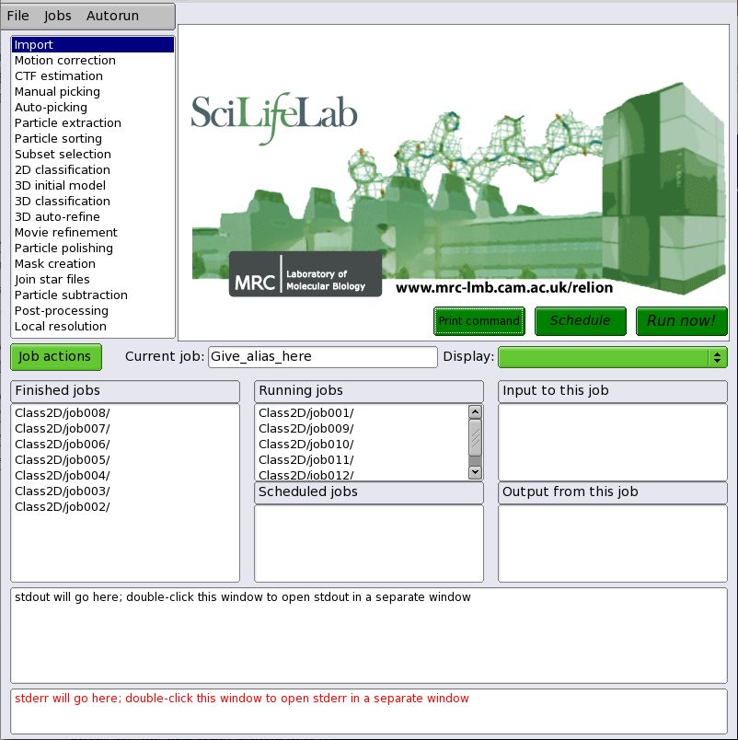
Using the GUI

Slide 62
Don't run GUI on the login node
Some job types run quickly
You will forget you are on the login node

Slide 63
Be aware of options passed to sinteractive
Default --mem-per-cpu=768
Subsequent batch MPI jobs may get confused
#!/bin/bash
#SBATCH --constraint=gpuk80
#SBATCH --ntasks=16
#SBATCH --nodes=4
#SBATCH --cpus-per-task=4
#SBATCH --mem=240g
#SBATCH --partition=XXXqueueXXX
#SBATCH --gres=gpu:k80:4,lscratch:XXXextra1XXX
#SBATCH --error=XXXerrfileXXX
#SBATCH --output=XXXoutfileXXX
#SBATCH --time=XXXextra2XXX
unset SLURM_MEM_PER_CPU
srun --mpi=pmi2 relion_refine_mpi –-i Particles
SLURM_MEM_PER_CPU=768
command line > environment variable > within batch script
SLURM_MEM_PER_CPU=768
SLURM_MEM_PER_NODE=245760
Always use --mem-per-cpu, unless you know what you are doing!
srun: Force Terminated job step 58421330.0
srun: error: cn2692: task 0: Killed
srun: error: cn2692: task 1: Killed
srun: Force Terminated job step 58421330.1

Slide 64
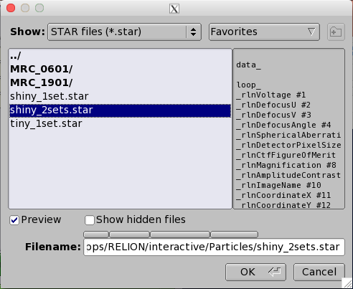
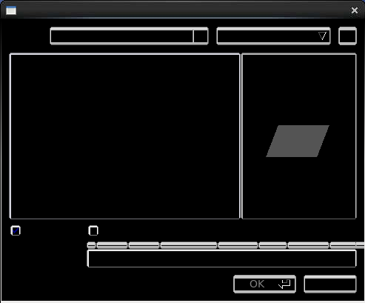
NX messes up file browsing
Xquartz:
NX:

Slide 65
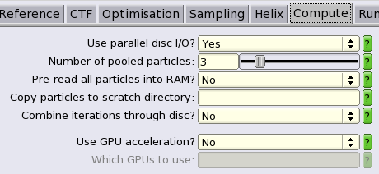
RELION Compute Options
Four major choices to be made:
--no_parallel_disc_io
always set to Yes
--preread_images
depends, exclusive from below
--scratch_dir=
usually good idea, exclusive from above
--dont_combine_weights_via_disc
always set to No
relion_command ... --dont_combine_weights_via_disc --scratch_dir=/lscratch/$SLURM_JOB_ID ...
or
relion_command ... --dont_combine_weights_via_disc --preread_images ...

Slide 66
Choice
Fastest execution (under ideal conditions) is to NOT use --scratch_dir or --preread_images
OK for short jobs, but long (>2h) and large jobs will have I/O hassles
--preread_images is perhaps a little faster
--scratch_dir most reliable

Slide 67
RELION/2.1.0-new
GUI code hacked to be more Slurm friendly
Allows a single batch script template
Will be the default under CentOS7

Slide 68
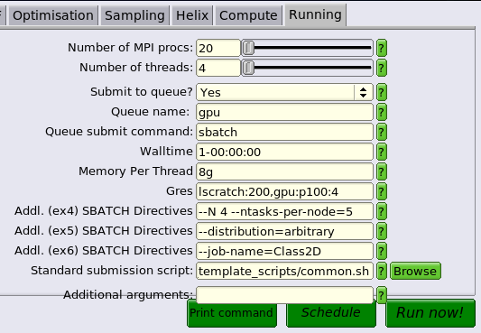
Running/Batch System Options
1 = non-MPI
>1 = MPI
must match job requirements
(norm, multinode, gpu)
--time must be set
--mem-per-cpu must be set
--gres is optional
Room for other sbatch options
/usr/local/apps/RELION/batch_template_scripts/common.sh

Slide 69
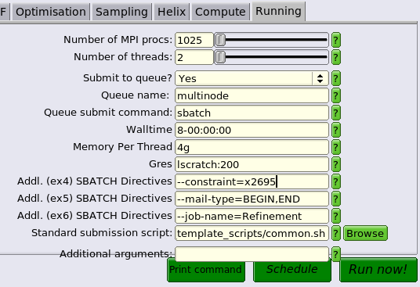
Running/Batch System Options
XXXmpinodesXXX, --ntasks
XXXthreadsXXX, --cpus-per-task
XXXqueueXXX, --partition
XXXextra1XXX, --time=
XXXextra2XXX, --mem-per-cpu=
XXXextra3XXX, --gres=
XXXextra4XXX (optional)
XXXextra5XXX (optional)
XXXextra6XXX (optional)
/usr/local/apps/RELION/batch_template_scripts/common.sh

Slide 70
common.sh batch script template
#!/bin/bash
#SBATCH --ntasks=XXXmpinodesXXX
#SBATCH --partition=XXXqueueXXX
#SBATCH --cpus-per-task=XXXthreadsXXX
#SBATCH --error=XXXerrfileXXX
#SBATCH --output=XXXoutfileXXX
#SBATCH --time=XXXextra1XXX
#SBATCH --mem-per-cpu=XXXextra2XXX
#SBATCH --gres=XXXextra3XXX
#SBATCH XXXextra4XXX
#SBATCH XXXextra5XXX
#SBATCH XXXextra6XXX
source restrict_tcp_for_mpi.sh
source add_extra_MPI_task.sh
srun --mem-per-cpu=XXXextra2XXX --mpi=pmi2 XXXcommandXXX

Slide 71
Memory
Minimum amount of memory (per MPI rank) for --preread_images =
E.g. 100K particles, 360 pixel box will need at least 48GB per task
Memory use will grow 10-20% over time
Convert to --mem-per-cpu = [calc RAM required]/--cpus-per-task
Same example above with -j 4 (--cpus-per-task=4) needs 14g per cpu
number of particles * box_size * box_size * 4 / (1024 * 1024 * 1024)

Slide 72
"Dumb down" the network interface
export OMPI_MCA_btl="self,sm,tcp"
export OMPI_MCA_btl_tcp_if_include="10.2.0.0/18"
No difference in execution time between Infiniband and plain 'ol TCP
MPI RELION can get confused on management network interfaces (10.90)
Will give warnings when a network interface doesn't exist
Automated with restrict_tcp_for_mpi.sh script

Slide 73

Check twice, run once
run or submit immediately
create subdirectory, files, expected files, but don't run
only display the RELION command to be run

Slide 74
RELION Job Monitoring
run.out and run.err files
jobhist, jobload, jobdata
dashboard
nvidia-smi

Slide 75
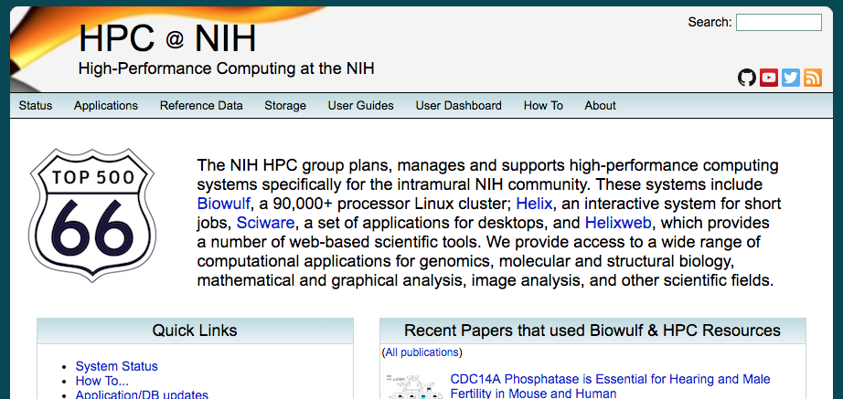
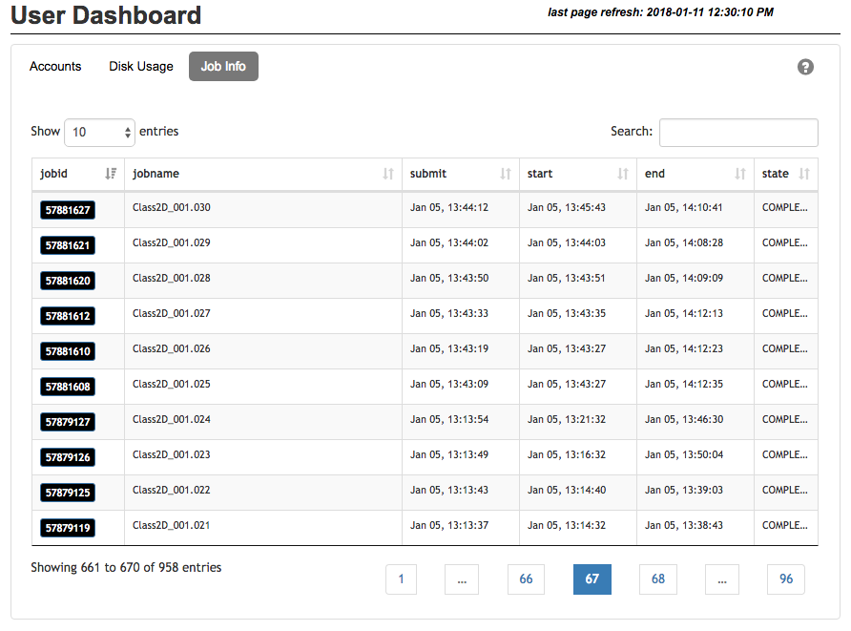
Dashboard
Jobs remain listed on the dashboard for 10 days after ending
Search by jobid, jobname, timestamp, state

Slide 76
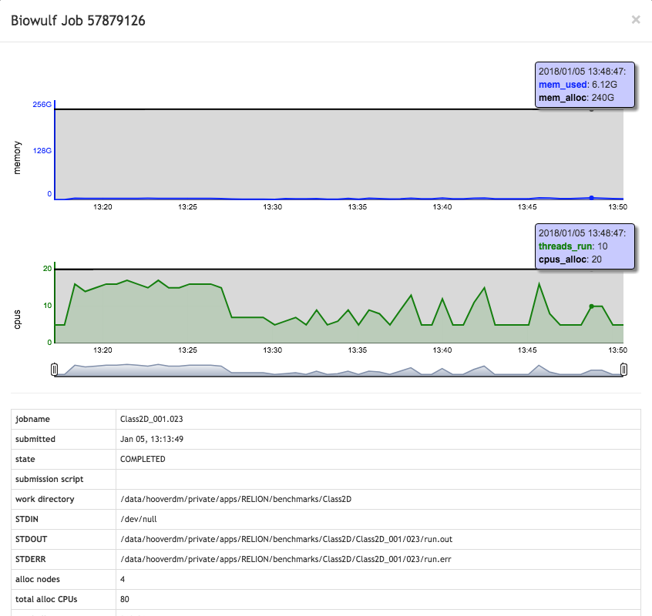
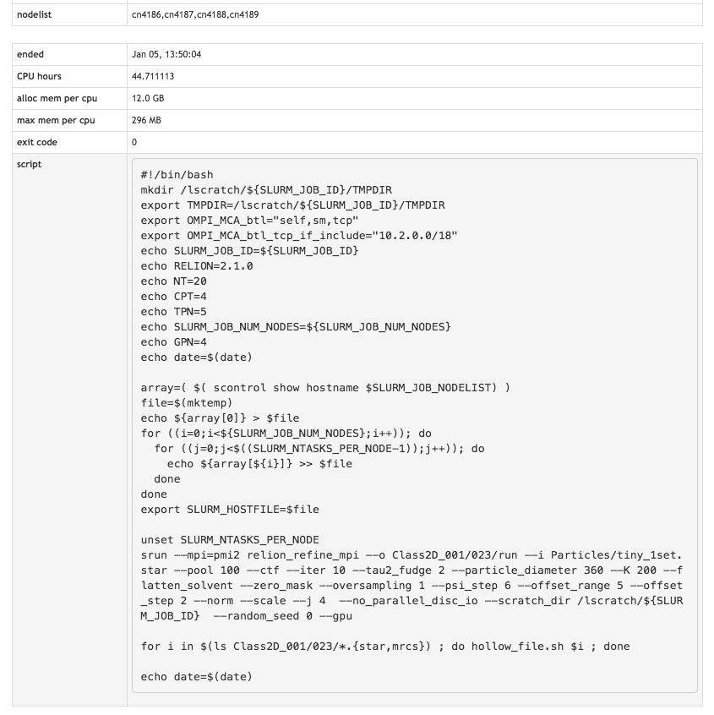
Dashboard

Slide 77
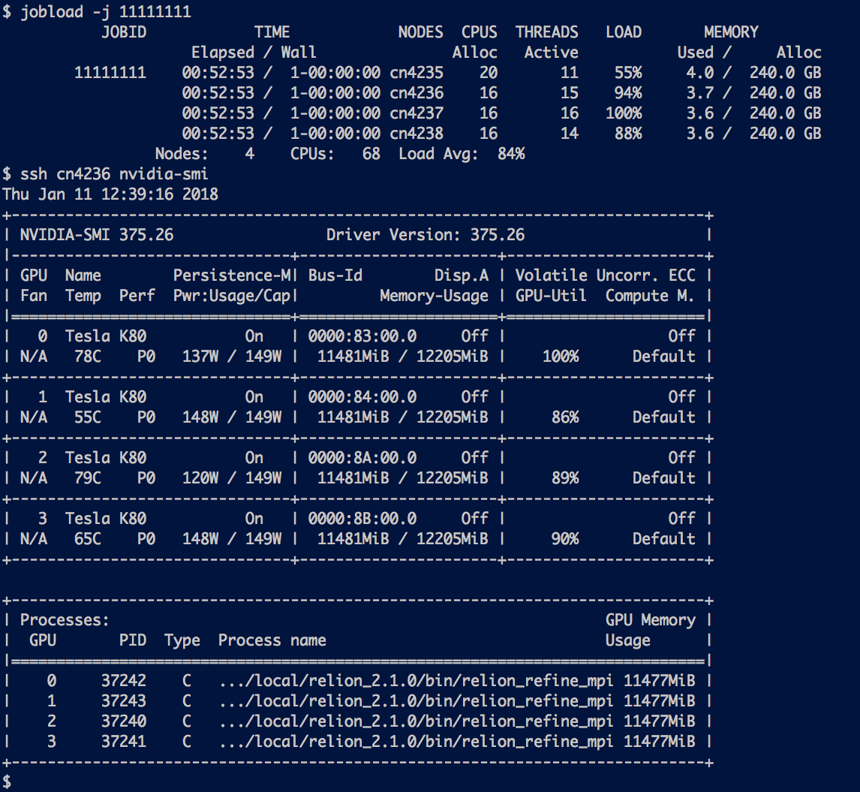
nvidia-smi
While job is running, display snapshot of GPU utilization

Slide 78
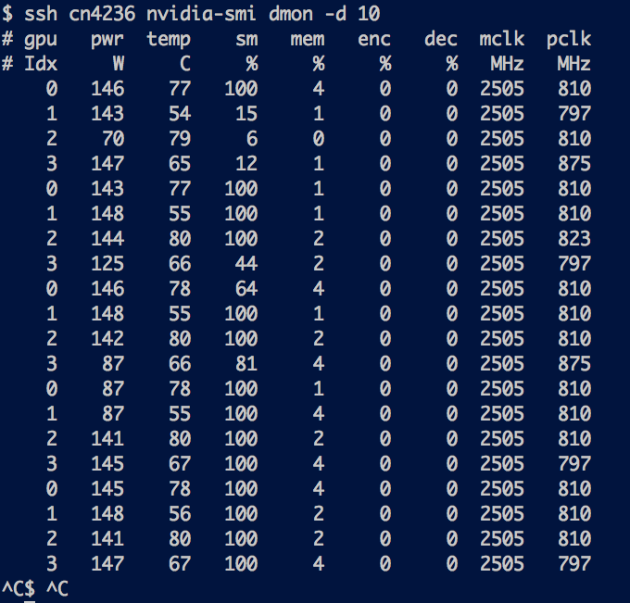
nvidia-smi dmon –d 10
Continuously monitor GPU utilization for defined periods of time
dmon is highly configurable

Slide 79
Troubleshooting
RELION touches every weak and sensitive point in the cluster
Many different ways things can go south

Slide 80
Insufficient Memory
Insufficient memory causes individual MPI ranks to be killed, leading to "zombie" RELION jobs
run.err shows something like this:
Job continues to run, but run.out does not progress
Other causes for rank failure include network hiccups, quota overrun, generic hardware failure
srun: error: cn3068: task 3: Killed

Slide 81
Insufficient GPU Memory
k80 GPUs have access to 12 GB VRAM
p100 GPUs have 16 GB VRAM
Downscale images
Recompile in single-precision
***WARNING***
With the current settings and hardware, you will be able to
use an estimated image-size of 533 pixels during the last iteration...
...but your input box-size (image_size) is however 659. This means that
you will likely run out of memory on the GPU(s), and will have to then re-start
from the last completed iteration (i.e. continue from it) *without* the use of GPUs.
You are also splitting at least one GPU between two or more mpi-slaves, which
might be the limiting factor, since each mpi-slave that shares a GPU increases the
use of memory. In this case we recommend running a single mpi-slave per GPU, which
will still yield good performance and possibly a more stable execution.

Slide 82
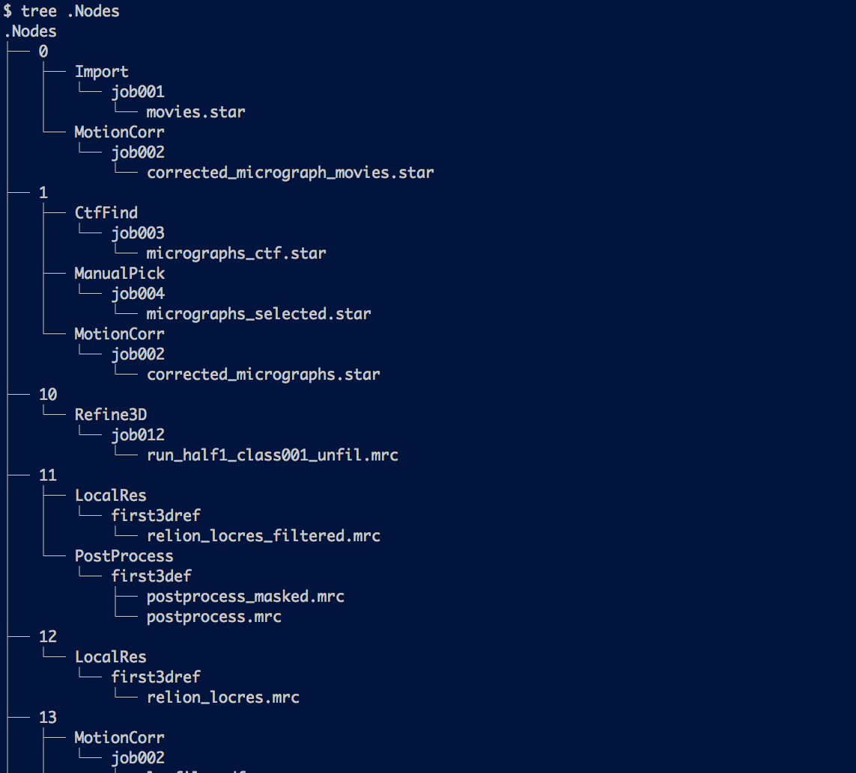
Mixing RELION Versions
PipeLine::read: cannot find name or type in pipeline_nodes table
The GUI creates hidden files for maintaining state between sessions under .Nodes
Running a different version of RELION on top of .Nodes may cause corruption

Slide 83
Inappropriate RELION Options
Almost always diagnosable from .out and .err files
Contact RELION developers or CCPEM mailing list if warning is unclear
Mixing --preread_images and --scratch_dir
Too many classes (--K)
--write_fom_maps from within AutoPick

Slide 84
I/O
Chronic problem nowadays
Certain steps (copying to /lscratch, reading into memory) take inordinately long
Don't launch 1000's of nodes simultaneously – stagger
Use GPUs whenever possible
ALWAYS SET --dont_combine_weights_via_disc

Slide 85
Bad Input
Filter and prune your data!
Choose only the best images, particles, and classes
More data does NOT mean better results

Slide 86

Questions? Comments?
staff@hpc.nih.gov

