Slide 1
Bash Shell Scripting for HPC
Dr. David Hoover, HPC @ NIH
staff@hpc.nih.gov

Slide 2
This Presentation Online
https://hpc.nih.gov/training

Slide 3
Guide To This Presentation
These lines are narrative information
Beige boxes are interactive terminal sessions:
Gray boxes are file/script contents:
White boxes are commands:
$ echo Today is $(date)
This is the first line of this file.
This is the second line.
echo Today is $(date)
Notes:
Gray and white boxes allow cut and paste of contents. Beige boxes do NOT NECESSARILY allow cut and paste, as they can contain extra characters, such as prompts and comments.

Slide 4
Terminal Emulators
PuTTY (http://www.chiark.greenend.org.uk/~sgtatham/putty/)
iTerm2 (http://iterm2.com/)
NoMachine (https://www.nomachine.com/)
MobaXterm (https://mobaxterm.mobatek.net/)

Slide 5
Connect to Biowulf
open terminal window on desktop, laptop
DON'T USE 'user'. Replace with YOUR login.
$ ssh user@biowulf.nih.gov

Slide 6
Start Interactive Session
Allocate 5 GB local scratch space
Default 8 hours of walltime
Default 2 CPUs and 1.5 GB RAM
sinteractive --gres=lscratch:5

Slide 7
Copy Examples
Create a working directory
Copy files recursively to your own directory
mkdir bash_class
cd bash_class
cp -R /data/classes/bash/* .

Slide 8
Copy Examples
Not on Helix/Biowulf:
mkdir bash_class
cd bash_class
curl \
https://hpc.nih.gov/training/handouts/BashScripting.tgz \
> BashScripting.tgz
tar -x -z -f BashScripting.tgz

Slide 9

History and introduction

Slide 10
Bash
Bash is a shell, like Bourne, Korn, and C
Written and developed by the FSF in 1989
Default shell for most Linux flavors

Slide 11
Definitive References
http://www.gnu.org/software/bash/manual/
http://www.tldp.org/
http://wiki.bash-hackers.org/
Notes:
tldp = The Linux Documentation Project

Slide 12
Bash on HPC
All machines within HPC run Bash v4.2.46

Slide 13
You might be using Bash already
$ ssh user@biowulf.nih.gov
...
Last login: Wed Aug 10 12:27:09 2018 from 123.456.78.90
$ echo $SHELL
/bin/bash
If not, just start a new shell:
$ bash

Slide 14
What shell are you running?
You should be running bash:
Maybe you're running something else?
$ echo $0
-bash
$ echo $0
-ksh
-csh
-tcsh
-zsh

Slide 15
Shell, Kernel, What?
user
screen
keyboard
SHELL
applications
kernel
hardware (CPU, memory, etc.)

Slide 16

Essentials

Slide 17
*nix Prerequisite
It is essential that you know something about UNIX or Linux
Introduction to Linux (Helix Systems)
https://hpc.nih.gov/training
Linux Tutorial at TACC
Linux Tutorial at TLDP

Slide 18
Elemental Bash
Bash is a command processor: interprets characters typed on the command line and tells the kernel what programs to use and how to run them
AKA command line interpreter (CLI)

Slide 19
Potpourri of commands

Slide 20
Simple Command
prompt
command
arguments
$ echo Hello World!
simple command

Slide 21
Essential *nix Commands
cd | ls | pwd | file | wc | find | du
chmod | touch | mv | cp | rm | cut | paste
sort | split | cat | grep | head | tail | less
more | sed | awk | diff | comm | ln
mkdir | rmdir | df | pushd | popd
date | exit | ssh | rsh | printenv | time | echo
ps | jobs | [CTRL-c] | [CTRL-z] | [CTRL-d] | top | kill
apropos | info | man | help | type

Slide 22
Comprehensive List
https://hpc.nih.gov/training/handouts/BashScripting_LinuxCommands.pdf

Slide 23
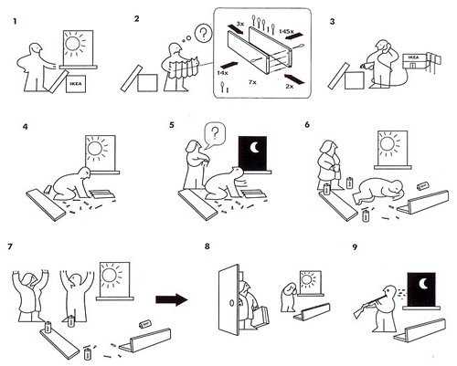
Documentation

Slide 24
Documentation
[google]
info
man
help
type
--help

Slide 25
Documentation: info
info is a comprehensive commandline documentation viewer
displays various documentation formats
$ info kill
$ info diff
$ info read
$ info strftime
$ info info

Slide 26
Documentation: man
$ man pwd
$ man diff
$ man head
Notes:
Make sure to run help.

Slide 27
Documentation: type
type is a builtin that displays the type of a word
$ type -t rmdir
file
$ type -t if
keyword
$ type -t echo
builtin
$ type -t module
function
$ type -t ls
alias

Slide 28
builtin
Bash has built-in commands (builtin)
echo, exit, hash, printf

Slide 29
Documentation: builtin
Documentation can be seen with help
Specifics with help [builtin]
$ help
$ help pwd
Notes:
Make sure to run help.

Slide 30
Non-Bash Commands
Found in /bin, /usr/bin, and
/usr/local/bin
Some overlap between Bash builtin and external executables
$ help time
$ man time
$ help pwd
$ man pwd

Slide 31
--help, -h
Many commands have (or should have) a help menu
Sometimes -h works as well, but not always
$ find --help
$ sbatch -h

Slide 32

scripts

Slide 33
Why write a script?
One-liners are not enough
Quick and dirty prototypes
Maintain library of functional tools
Glue to string other apps together
Batch system submissions

Slide 34
What is in a Script?
Commands
Variables
Functions
Loops
Conditional statements
Comments and documentation
Options and settings

Slide 35
My Very First Script
create a script and inspect its contents:
call it with bash:
results:
echo 'echo Hello World!' > hello_world.sh
cat hello_world.sh
bash hello_world.sh
$ bash hello_world.sh
Hello World!

Slide 36
Multiline file creation
create a multiline script:
$ cat << ALLDONE > hello_world_multiline.sh
> echo Hello World!
> echo Yet another line.
> echo This is getting boring.
> ALLDONE
$
$ bash hello_world_multiline.sh
Hello World!
Yet another line.
This is getting boring.
$

Slide 37
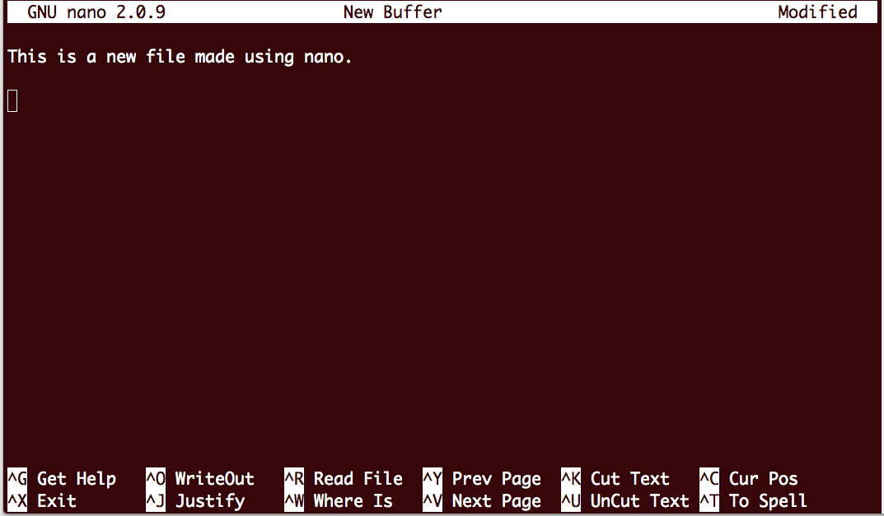
nano file editor

Slide 38
Other Editors
SciTE
gedit
nano and pico
vi, vim, and gvim
emacs
Use dos2unix if text file created on Windows machine

Slide 39
Execute With A Shebang!
If bash is the default shell, making it executable allows it to be run directly
Adding a shebang specifies the scripting language:
chmod +x hello_world.sh
./hello_world.sh
#!/bin/bash
echo Hello World!

Slide 40
Debugging
Call bash with -x -v
-x displays commands and their results
-v displays everything, even comments and spaces
-xv can be combined
bash -x -v hello_world.sh
#!/bin/bash -xv
echo Hello World!

Slide 41
A Word About The Shebang
The shebang allows only one argument
is ok
is not ok
#!/bin/bash -xv
echo Hello World!
#!/bin/bash -x -v
echo Hello World!

Slide 42
examples/input/args.sh
echo You passed $# arguments to the script
echo The first three arguments are:
echo $1
echo $2
echo $3

Slide 43
Special Parameters - Positional
Positional parameters are arguments passed to the shell when invoked
Denoted by ${digit}, > 0
Normally used with scripts and functions
$ cat x.sh
#!/bin/bash
echo ${4} ${15} ${7} ${3} ${1} ${20}
$ bash x.sh {A..Z}
D O G C A T

Slide 44
Shell Parameters - Special
Special parameters have a single character
$* expands to the positional parameters
$@ the same as $*, but as array rather than string
$# number of positional parameters
$- current option flags when shell invoked
$$ process id of the shell
$! process id of last executed background command
$0 name of the shell or shell script
$_ final argument of last executed foreground command
$? exit status of last executed foreground command

Slide 45
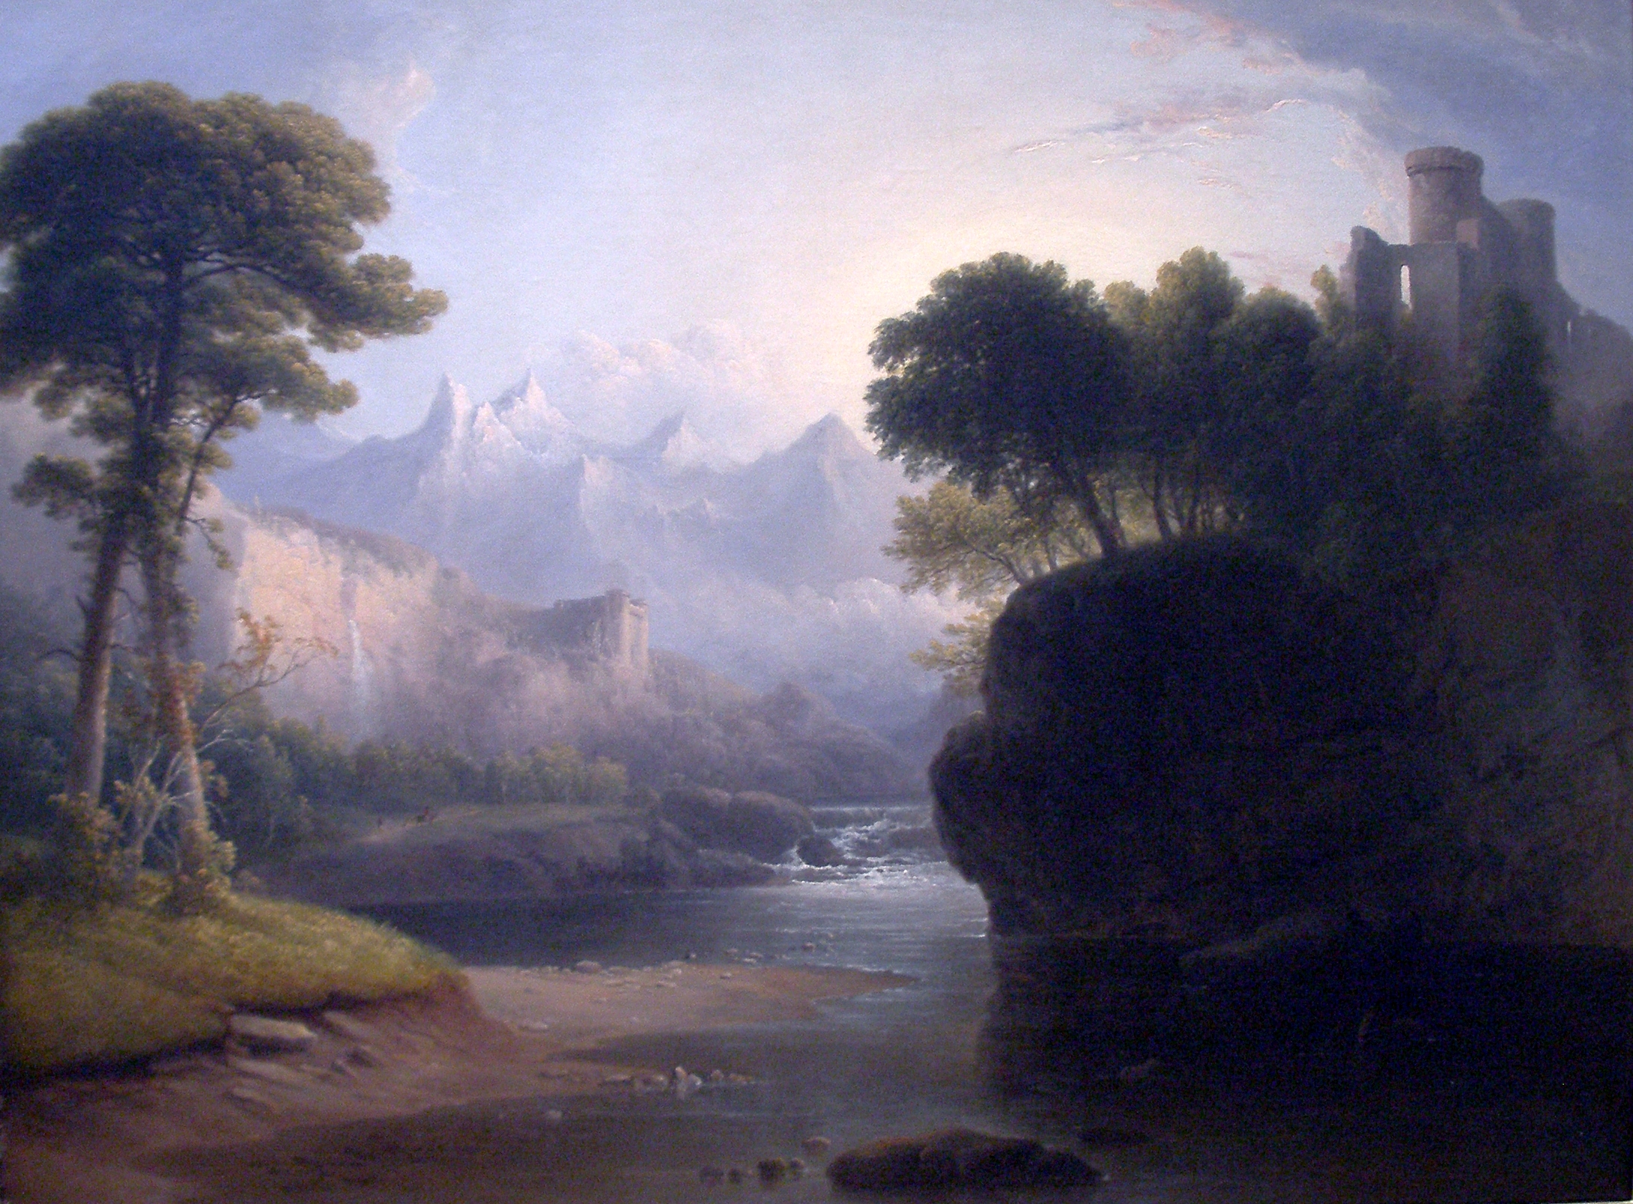
Setting the environment

Slide 46
Environment
A set of variables and functions recognized by the kernel and used by most programs
Not all variables are environment variables, must be exported
Initially set by startup files
printenv displays variables and values in the environment
set displays ALL variable

Slide 47
Variables
A variable is construct to hold information, assigned to a word
Variables are initially undefined
Variables have scope
Variables are a key component of the shell's environment

Slide 48
Using Variables
A simple script:
Variables simplify and make portable:
#!/bin/bash
cd /path/to/somewhere
mkdir /path/to/somewhere/test1
cd /path/to/somewhere/test1
echo 'this is boring' > /path/to/somewhere/test1/file1
#!/bin/bash
dir=/path/to/somewhere
cd $dir
mkdir $dir/test1
cd $dir/test1
echo 'this is boring' > $dir/test1/file1

Slide 49
Set a variable
Formally done using declare
Very simple, no spaces
declare myvar=100
myvar=10

Slide 50
Set a variable
Examine value with echo and $:
This is actually parameter expansion
$ echo $myvar
10

Slide 51
export
export is used to set an environment variable:
You can do it one move
MYENVVAR=10
export MYENVVAR
printenv MYENVVAR
export MYENVVAR=10

Slide 52
unset a variable
unset is used for this
Can be used for environment variables
unset myvar
$ echo $HOME
/home/user
$ unset HOME
$ echo $HOME
$ export HOME=/home/user

Slide 53
Remove from environment
export -n
$ declare myvar=10
$ echo $myvar
10
$ printenv myvar # nothing – not in environment
$ export myvar
$ printenv myvar # now it's set
10
$ echo $myvar
10
$ export -n myvar
$ printenv myvar # now it's gone
$ echo $myvar
10

Slide 54
Bash Variables
$HOME = /home/[user] = ~
$PWD = current working directory
$PATH = list of filepaths to look for commands
$TMPDIR = temporary directory (/tmp)
$RANDOM = random number
Many, many others…

Slide 55
printenv
$ printenv
HOSTNAME=biowulf.nih.gov
TERM=xterm
SHELL=/bin/bash
HISTSIZE=500
SSH_CLIENT=96.231.6.99 52018 22
SSH_TTY=/dev/pts/274
HISTFILESIZE=500
USER=student1

Slide 56
module
module can set your environment
Can be used for environment variables
module load python/2.7
module unload python/2.7
module avail
https://hpc.nih.gov/apps/modules.html

Slide 57
Setting Your Prompt
The $PS1 variable (primary prompt, $PS2 and $PS3 are for other things)
Has its own format rules
Example:
PS1="[\u@\h \W]$ "
[user@host myDir]$ echo Hello World!
Hello World!
[user@host myDir]$

Slide 58
Setting Your Prompt
\d date ("Tue May 6")
\h hostname ("helix")
\j number of jobs
\u username
\W basename of $PWD
\a bell character (why?)
http://www.tldp.org/HOWTO/Bash-Prompt-HOWTO/index.html
http://www.gnu.org/software/bash/manual/bashref.html#Printing-a-Prompt

Slide 59

Command line interpreter

Slide 60
Watch What You Write
Bash interprets what you write after you hit return
Patterns of characters can cause expansion

Slide 61
Parameter Expansion
$ is placed outside for parameter expansion
Braces can be used to preserve variable
name=monster
echo $name
monster
echo $name_silly
echo ${name}_silly
monster_silly

Slide 62
Parameter Expansion
More than one in a row
$ var1=cookie
$ var3=_is_silly
$ echo ${var1}_${name}${var3}
cookie_monster_is_silly

Slide 63
Brace Expansions
Brace expansion { , , }
echo {bilbo,frodo,gandalf}
bilbo frodo gandalf
echo {0,1,2,3,4,5,6,7,8,9}
0 1 2 3 4 5 6 7 8 9

Slide 64
Brace Expansions
Brace expansion { .. }
echo {0..9}
0 1 2 3 4 5 6 7 8 9
$ echo {b..g}
b c d e f g
echo {bilbo..gandalf}
{bilbo..gandalf}

Slide 65
Brace Expansions
Nested brace expansions
mkdir z{0,1,2,3,4,5,6,7,8,9}
ls
z0 z1 z2 z3 z4 z5 z6 z7 z8 z9
rmdir z{{1..4},7,8}
ls
z0 z5 z6 z9

Slide 66
Brace Expansions
Distinct from parameter expansion $ or ${
echo {$var1,${name},brought,to,you,by,{1..3}}
cookie monster brought to you by 1 2 3

Slide 67
Arithmetic Expansion
(( )) is used to evaluate math
$ is placed outside for parameter expansion
echo ((12-7))
-bash: syntax error near unexpected token `('
echo $((12-7))
5

Slide 68
Arithmetic Expansion
Variables can be updated, not just evaluated
a=4
b=8
echo $a
4
echo $b
8
echo $((a+b))
12

Slide 69
Arithmetic Expansion
Variables can be updated, not just evaluated
echo $a
4
echo $b
8
echo $((a=a+b))
12
echo $a
12

Slide 70
Arithmetic Expansion
The ++ and -- operators only work on variables, and update the value
a=4
((a++))
echo $a
5
unset b
((b--))
echo $b
-1

Slide 71
Arithmetic – integers only
Bash can only handle integers
a=4.5
((a=a/3))
-bash: ((: 4.5: syntax error: invalid arithmetic operator (error token is ".5")

Slide 72
Arithmetic – integers only
Bash can only do integer math
Division by zero is caught with exit status
a=3
((a=a/7))
echo $a
0
((a=a/0))
-bash: let: a=a/0: division by 0 (error token is "0")

Slide 73
Arithmetic Expansion
Math is done using let and ‘(( ))’
$ a=1
$ echo $a
1
$ let a++
$ echo $a
2
$ ((a++))
$ echo $a
3
$ let a=a+4
$ echo $a
7

Slide 74
Command Substitution
` = backtick
better to use $()
echo uname -n
uname –n
echo `uname -n`
biowulf.nih.gov
echo $(uname -n)
biowulf.nih.gov

Slide 75
Command Substitution
Nested processes
y=$(wc -l $(find scripts/ -type f) | tail -n 1)
echo $y
633 total
Notes:
This command does a recursive listing, then gathers the line count of each entry. All errors are thrown away (/dev/null), and only the sum total is kept.

Slide 76
Tab Expansion
hit tab here
$ ls /usr/
bin/ lib/ local/ sbin/ share/
$ ls /usr/

Slide 77
Tilde Expansion
$ echo ~
/home/user

Slide 78
Quotes
Single quotes preserve literal values
Double quotes allow variable and shell expansions
echo 'cd $PWD $(uname -n)'
cd $PWD $(uname -n)
echo "cd $PWD $(uname -n)"
cd /home/user biowulf.nih.gov

Slide 79
Quotes
Double quotes also preserve blank characters
use $'\t' to insert a tab
use $'\n' to insert a newline
$ msg=$(echo Hi$'\t'there.$'\n'How are you?)
$ echo $msg
Hi there. How are you?
$ echo "$msg"
Hi there.
How are you?
tab, not space

Slide 80
Escapes
The escape character ‘\’ preserves literal value of following character
However, it treats newline as line continuation
echo \$PWD is $PWD
$PWD is /home/user
echo \$PWD is $PWD \
something else
$PWD is /home/user something else

Slide 81
Escapes
Funny non-printing characters
$'char'
echo Hello World
Hello World
echo $'\n\n'Hello$'\t\t'World$'\n\n'
Hello World

Slide 82

Arrays

Slide 83
What is an array
An array is a linear, ordered set of values
The values are indexed by integers
value
value
value
value
0
1
2
3

Slide 84
Arrays
Arrays are indexed by integers (0,1,2,…)
Arrays are referenced with {} and []
array=(apple pear fig)
$ echo ${array[*]}
apple pear fig
$ echo ${array[2]}
fig
$ echo ${#array[*]}
3

Slide 85
Arrays vs. Variables
Arrays are actually just an extension of variables
$ var1=apple
$ echo $var1
apple
$ echo ${var1[0]}
apple
$ echo ${var1[1]}
$ echo ${#var1[*]}
1
$ var1[1]=pear
$ echo ${#var1[*]}
2
Notes:
Variables can be exported into the environment. An array CAN NOT be exported.

Slide 86
Arrays vs. Variables
Unlike a variable, an array CAN NOT be exported to the environment
An array CAN NOT be propagated to subshells

Slide 87
Arrays and Loops
Arrays are very helpful with loops
for i in ${array[*]} ; do echo $i ; done
apple
pear
fig

Slide 88
Using Arrays
The number of elements in an array
Walk an array by index
num=${#array[@]}
$ for (( i=0 ; i < ${#array[@]} ; i++ ))
> do
> echo $i: ${array[$i]}
> done
0: apple
1: pear
2: fig

Slide 89
Arrays * vs @
* concatenates all elements when quoted
$ for i in ${array[*]}; do echo $i ; done
apple
pear
fig
$ for i in ${array[@]}; do echo $i ; done
apple
pear
fig
$ for i in "${array[*]}"; do echo $i ; done
apple pear fig
$ for i in "${array[@]}"; do echo $i ; done
apple
pear
fig

Slide 90
Careful thinking
Add one more tricky element
See what happens
array+=("blood orange")
for i in ${array[*]}; do echo $i ; done
for i in ${array[@]}; do echo $i ; done
for i in "${array[*]}"; do echo $i ; done
for i in "${array[@]}"; do echo $i ; done

Slide 91
examples/arrays/arrays.sh
declare -a array
array=(apple pear fig)
echo There are ${#array[*]} elements in the array
echo Here are all the elements in one line: ${array[*]}
echo Here are the elements with their indices:
for (( i=0 ; i < ${#array[@]} ; i++ ))
do
echo " $i: ${array[$i]}"
done

Slide 92
ASSOCIATIVE Arrays

Slide 93
Associative Arrays
Unordered, indexed collection of values
assoc_array
key
key
key
value
value
value

Slide 94
Associative Arrays
Indexed by strings instead of integers, requires declare -A
Associative arrays have keys and values
declare -A assoc_array=([huey]=red [dewie]=blue [louie]=green)
$ echo ${assoc_array[huey]}
red
$ echo ${assoc_array[dewie]}
blue
$ echo ${#assoc_array[*]}
3

Slide 95
Associative Arrays
Values are displayed by default
Keys require prefixing !
Ordering is lost
$ echo ${assoc_array[*]}
green blue red
$ echo ${!assoc_array[*]}
louie dewie huey

Slide 96
examples/arrays/assoc_array.sh
declare -A assoc_array=([huey]=red [dewie]=blue [louie]=green)
for key in ${!assoc_array[@]}
do
echo key: $key, value: ${assoc_array[$key]}
done

Slide 97
Associative Array
If ordering is important, will need to maintain both regular and associative array
$ ordered_array=(huey dewie louie)
$ for i in ${ordered_array[@]} ; do
> echo key: $i, value: ${assoc_array[$i]}
> done
key: huey, value: red
key: dewie, value: blue
key: louie, value: green

Slide 98
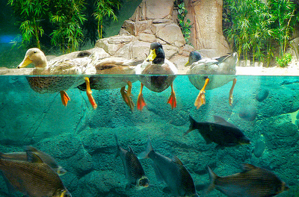
Aliases and Functions

Slide 99
Aliases
A few aliases are set by default
Can be added or deleted
Remove all aliases
$ alias
alias l.='ls -d .* --color=auto'
alias ll='ls -l --color=auto'
alias ls='ls --color=auto’
alias edit='nano'
$ unalias ls
$ alias ls='ls –CF’
$ unalias -a

Slide 100
Aliases
Aliases belong to the shell, but NOT the environment
Aliases can NOT be propagated to subshells
Limited use in scripts
Only useful for interactive sessions

Slide 101
Aliases Within Scripts
Aliases have limited use within a script
Aliases are not expanded within a script by default, requires special option setting:
Worse, aliases are not expanded within conditional statements, loops, or functions
$ shopt -s expand_aliases

Slide 102
Functions
functions are a defined set of commands assigned to a word
function status { date; uptime; who | grep $USER; checkquota; }
$ status
Thu Aug 18 14:06:09 EDT 2016
14:06:09 up 51 days, 7:54, 271 users, load average: 1.12, 0.91, 0.86
user pts/128 2013-10-17 10:52 (128.231.77.30)
Mount Used Quota Percent Files Limit
/data: 92.7 GB 100.0 GB 92.72% 233046 6225917
/home: 2.2 GB 8.0 GB 27.48% 5510 n/a

Slide 103
Functions
display what functions are set:
display code for function:
declare -F
declare -f status
status ()
{
date;
uptime;
who | grep --color $USER;
checkquota
}

Slide 104
Functions
functions can propagate to child shells using export
export -f status

Slide 105
Functions
unset deletes function
unset status

Slide 106
Functions
local variables can be set using local
$ export TMPDIR=/tmp
$ function processFile {
> local TMPDIR=/data/user/tmpdir
> echo $TMPDIR
> sort $1 | grep $2 > $2.out
> }
$ processFile /path/to/file string
/data/user/tmpdir
$ echo $TMPDIR
/tmp

Slide 107
Three ways to leave a function
nothing (default)
return
exit (danger!)
function test1 { echo test1; }
function test2 { echo test2; return; }
function test3 { echo test3; exit; }

Slide 108
Location of function in script
A function must be defined prior to call
function doSomething
{
echo using $1
}
doSomething

Slide 109
examples/functions/function.sh
function throwError
{
echo ERROR: $1
exit 1
}
tag=$USER.$RANDOM
throwError "No can do!"
mkdir $tag
cd $tag

Slide 110
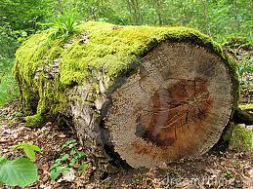
LOGIN

Slide 111
Logging In
ssh is the default login client
what happens next?
$ ssh $USER@biowulf.nih.gov

Slide 112
Bash Flow
ssh login
bash
/etc/profile
/etc/profile.d/*
~/.bash_profile
~/.bash_login
~/.profile
user session
bash
/etc/bashrc
~/.bashrc
user session
background
interactive login
interactive non-login
bash script
background
background
non-interactive
$BASH_ENV
script process
user session
exit
user session
~/.bash_logout
logout
exit

Slide 113
Logging In
Interactive login shell (ssh from somewhere else)
/etc/profile
~/.bash_profile
~/.bash_logout (when exiting)
The startup files are sourced, not executed

Slide 114
source and .
source executes a file in the current shell and preserves changes to the environment
. is the same as source
Legacy from Bourne shell

Slide 115
~/.bash_profile
cat ~/.bash_profile
# Get the aliases and functions
if [ -f ~/.bashrc ]; then
. ~/.bashrc
fi
# User specific environment and startup programs
PATH=$PATH:$HOME/bin
export PATH

Slide 116
Non-Login Shell
Interactive non-login shell (calling bash from the commandline)
Retains environment from login shell
Shell levels seen with $SHLVL
~/.bashrc
$ echo $SHLVL
1
$ bash
$ echo $SHLVL
2

Slide 117
~/.bashrc
cat ~/.bashrc
# .bashrc
# Source global definitions
if [ -f /etc/bashrc ]; then
. /etc/bashrc
fi
# User specific aliases and functions

Slide 118
Non-Interactive Shell
From a script
Retains environment from login shell
Set to a file like ~/.bashrc
$BASH_ENV (if set)

Slide 119
Arbitrary Startup File
User-defined (e.g. ~/.my_profile)
Can also use '.'
$ source ~/.my_profile
[dir user]!
$ . ~/.my_profile
[dir user]!

Slide 120
examples/functions/function2.sh
source function_depot.sh
tag=$USER.$RANDOM
throwError "No can do!"
cd $tag

Slide 121

Simple Commands

Slide 122
Definitions
Command
word
Simple command /
process
command arg1 arg2 …
Pipeline / Job
simple command 1 | simple command 2 |& …
List
pipeline 1 ; pipeline 2 ; …
Notes:
Command = word that tells the kernel to do something, such as run a program.
Simple command = series of words terminated by the shell’s control operators. The first word is usually a program or command.
Pipeline = sequence of simple commands separated by ‘|’ or ‘|&’.
List = sequence of pipelines separated by ‘;’, ‘&’, ‘&&’, or ‘||’, and optionally terminated by one of ‘;’, ‘&’, or a newline.

Slide 123
Some command examples
What is the current time and date?
Where are you?
date
pwd
Notes:
Command = word that tells the kernel to do something, such as run a program.
Simple command = series of words terminated by the shell’s control operators. The first word is usually a program or command.
Pipeline = sequence of simple commands separated by ‘|’ or ‘|&’.
List = sequence of pipelines separated by ‘;’, ‘&’, ‘&&’, or ‘||’, and optionally terminated by one of ‘;’, ‘&’, or a newline.

Slide 124
Simple Command
prompt
command
arguments
$ echo Hello World!
simple command

Slide 125
Simple commands
List the contents of your /home directory
How much disk space are you using?
What are you up to?
ls -l -a $HOME
du -h -s $HOME
ps -u $USER -o size,pcpu,etime,comm --forest
Notes:
Command = word that tells the kernel to do something, such as run a program.
Simple command = series of words terminated by the shell’s control operators. The first word is usually a program or command.
Pipeline = sequence of simple commands separated by ‘|’ or ‘|&’.
List = sequence of pipelines separated by ‘;’, ‘&’, ‘&&’, or ‘||’, and optionally terminated by one of ‘;’, ‘&’, or a newline.

Slide 126
Command Search Tree
Command
Slashes?
yes
Exec file?
no
function?
Alias expansion
yes
no
yes
no
builtin?
Execute command
Word expansion
yes
no
hit return
In $PATH
yes
$ cmd arg1 arg2
ERROR
no

Slide 127
Process
A process is an executing instance of a simple command
Can be seen using ps command
Has a unique id (process id, or pid)
Belongs to a process group

Slide 128
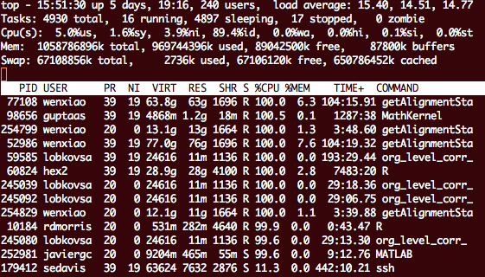
top command

Slide 129
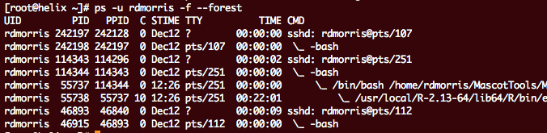
ps command

Slide 130
history
The history command shows old commands run:
$ history 10
594 12:04 pwd
595 12:04 ll
596 12:06 cat ~/.bash_script_exports
597 12:06 vi ~/.bash_script_exports
598 12:34 jobs
599 12:34 ls -ltra
600 12:34 tail run_tophat.out
601 12:34 cat run_tophat.err
602 12:54 history 10

Slide 131
history
HISTTIMEFORMAT controls display format
$ export HISTTIMEFORMAT='%F %T '
$ history 10
596 2018-10-16 12:06:22 cat ~/.bash_script_exports
597 2018-10-16 12:06:31 vi ~/.bash_script_exports
598 2018-10-16 12:34:13 jobs
599 2018-10-16 12:34:15 ls -ltra
600 2018-10-16 12:34:21 tail run_tophat.out
601 2018-10-16 12:34:24 cat run_tophat.err
602 2018-10-16 12:54:38 history 10
603 2018-10-16 12:56:14 export HISTTIMEFORMAT='%F %T '
604 2018-10-16 12:56:18 history 10
http://www.tldp.org/LDP/GNU-Linux-Tools-Summary/html/x1712.htm

Slide 132
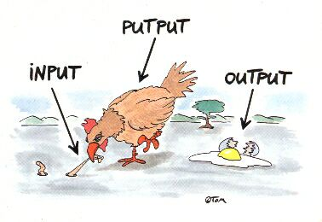
Input and Output

Slide 133
Redirection
Every process has three file descriptors (file handles): STDIN (0), STDOUT (1), STDERR (2)
Content can be redirected
cmd < x.in
Redirect file descriptor 0 from STDIN to x.in
cmd > x.out
Redirect file descriptor 1 from STDOUT to x.out
cmd 1> x.out 2> x.err
Redirect file descriptor 1 from STDOUT to x.out,
file descriptor 2 from STDERR to x.err

Slide 134
Combine STDOUT and STDERR
cmd 2>&1
Redirect file descriptor 2 from STDERR to wherever file descriptor 1 is pointing (STDOUT)
Ordering is important
Correct:
cmd > x.out 2>&1
Redirect file descriptor 1 from STDOUT to filename x.out, then redirect file descriptor 2 from STDERR to wherever file descriptor 1 is pointing (x.out)
Incorrect:
cmd 2>&1 > x.out
Redirect file descriptor 2 from STDERR to wherever file descriptor 1 is pointing (STDOUT), then redirect file descriptor 1 from STDOUT to filename x.out

Slide 135
Redirection to a File
Use better syntax instead – these all do the same thing:
cmd > x.out 2>&1
cmd 1> x.out 2> x.out
WRONG!
cmd &> x.out
cmd >& x.out

Slide 136
Redirection
Appending to a file
cmd >> x.out
Append STDOUT to x.out
cmd 1>> x.out 2>&1
Combine STDOUT and STDERR, append to x.out
cmd &>> x.out
Alternative for concatenation and appendation
cmd >>& x.out
WRONG!

Slide 137
Named Pipes/FIFO
Send STDOUT and/or STDERR into temporary file for commands that can't accept ordinary pipes
$ ls /home/$USER > file1_out
$ ls /home/$USER/.snapshot/Weekly.2018-12-30* > file2_out
$ diff file1_out file2_out > diff.out
$ rm file1_out file2_out
$ cat diff.out

Slide 138
Named Pipes/FIFO
FIFO special file can simplify this
You typically need multiple sessions or shells to use named pipes
[sess1]$ mkfifo pipe1
[sess1]$ ls /home/$USER > pipe1
[sess2]$ cat pipe1

Slide 139
Named Pipes/FIFO
Can be used to consolidate output without appending to a file
$ mkfifo pipe1 pipe2 pipe3
$ echo one > pipe1 &
$ echo two > pipe2 &
$ echo three > pipe3 &
$ cat pipe*

Slide 140
Process Substitution
The operators <( ) and >() can be used to create transient named pipes
AKA process substitution
The operators '> >()' are equivalent to '|'
$ diff <(ls /home/$USER) <(ls /home/$USER/.snapshot/Weekly.2018-12-30*)
$ cat /usr/share/dict/words > >(grep zag)

Slide 141
examples/pipes/fifo.sh
diff <(zcat examples/pipes/webfiles.new.gz | sort) <(zcat examples/pipes/webfiles.old.gz | sort)
# equivalent to:
#diff <(zcat examples/pipes/webfiles.new.gz > >(sort) ) <(zcat examples/pipes/webfiles.old.gz > >(sort) )

Slide 142
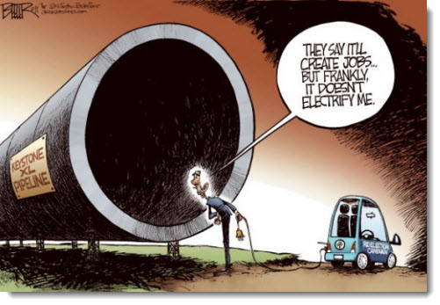
Pipelines And Jobs

Slide 143
Pipeline
STDOUT of each simple command is passed as STDIN of the next command
ps -ef | grep sh | head -n 3

Slide 144
Pipeline
STDERR can be combined with STDOUT
$ ls emptydir | grep -c 'No such file'
ls: cannot access emptydir: No such file or directory
0
$ ls emptydir 2>&1 | grep -c 'No such file'
1
$ ls emptydir |& grep -c 'No such file'
1

Slide 145
examples/pipes/pipes.sh
# The file genome_stuff.csv is a comma-delineated output
# file from an unamed application. You want to pull out
# the data related to chrX, converting the delineator to
# a tab character, then sort based on the SNP id, if
# present. Also, you want to maintain the column headers
# (the topmost line).
# Note the use of line continuation markers and named
# pipes.
input=examples/pipes/genome_stuff.csv
cat <(cut -d',' -f1,2,22-33 $input | head -1 \
| tr ',' $'\t') <(cut -d',' -f1,2,22-33 $input \
| grep chrX | tr ',' $'\t' | sort -k3)

Slide 146
Job Control
A job is another name for pipeline
Each simple command is a process
echo Hello World! > x | cat x | grep o

Slide 147
Foreground and Background
A job (pipeline) runs in the foreground by default
Asynchronous jobs are run in background (in parallel, fire and forget)
Requires single ‘&’ at the end
Background jobs run in their own shell
Exit status is not available
sleep 5 &

Slide 148
wait
The wait command does just that
useful for consolidation or summary steps
sleep 9 &
sleep 7 &
sleep 5 &
wait

Slide 149
Job Control
The shell itemizes jobs by number
$ sleep 10 &
[1] 8683
$ sleep 10 &
[2] 8684
$ sleep 10 &
[3] 8686
$ jobs
[1] Running sleep 10 &
[2]- Running sleep 10 &
[3]+ Running sleep 10 &
$
[1] Done sleep 10
[2]- Done sleep 10
[3]+ Done sleep 10

Slide 150
Job Control
A job can be moved from foreground to background with [CTRL-z] and bg
Can be brought back with fg
$ step1.sh | step2.sh | grep normal
[CTRL-z]
[1]+ Stopped step1.sh | step2.sh ..
bg
[1]+ step1.sh | step2.sh ..
$ jobs
[1]+ Running step1.sh | step2.. &
$ fg
step1.sh step2.sh ...

Slide 151
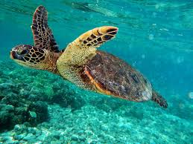
Subshells

Slide 152
Shells and Subshells
A shell is defined by a set of variables, options, and a current working directory (CWD)
Subshells (child shells) inherit the environment and CWD
Changes to the environment and CWD are not propagated back to the parent

Slide 153
Talking To Yourself
$ pwd
/home/user
$ export NUMBER=5
$ bash
$ ((NUMBER++))
$ echo $NUMBER
6
$ cd /scratch
$ exit
$ echo $NUMBER
5
$ pwd
/home/user
in a subshell

Slide 154
examples/subshells/subshell.sh
pwd
for i in {1..4} ; do
(
BASE=/tmp/$i.$RANDOM
mkdir $BASE ; echo -n "OLD DIR: " ; pwd
cd $BASE ; echo -n "NEW DIR: " ; pwd
sleep 2
rmdir $BASE
)
done
pwd
Notes:
Subshells are useful when you need to create a temporary work area, and you don't want to keep track of where you are and where you came from.

Slide 155
examples/subshells/exit.sh
(
echo this is running in a subshell
echo exiting now
exit
)
echo intermission
{
echo this is running in the current shell
echo exiting now
exit
}
echo all done!

Slide 156

Command Lists

Slide 157
Command List
Sequence of one or more jobs separated by ‘;’, ‘&’, ‘&&’, or ‘||’.
Simple commands/pipelines/jobs are run sequentially when separated by ‘;’
echo 1 > x ; echo 2 > y ; echo 3 > z
date ; sleep 5 ; sleep 5 ; sleep 5 ; date

Slide 158
Command List
Sequential command list is equivalent to
or
echo 1 > x
echo 2 > y
echo 3 > z
date
sleep 5
sleep 5
sleep 5
date

Slide 159
Command List
Asynchronously when separated by ‘&’
wait pauses until all background jobs complete
echo 1 > x & echo 2 > y & echo 3 > z &
date ; sleep 5 & sleep 5 & sleep 5 & wait ; date

Slide 160
Command List
Asynchronous command list is equivalent to
or
echo 1 > x &
echo 2 > y &
echo 3 > z &
date
sleep 5 &
sleep 5 &
sleep 5 &
wait
date

Slide 161
Grouped Command List
To execute a list of sequential pipelines in the background, or to pool STDOUT/STDERR, enclose with ‘()’ or ‘{}’
STDIN is NOT pooled, but must be redirected with each command or pipeline.
$ ( cmd 1 < input ; cmd 2 < input ) > output &
[1] 12345
$ { cmd 1 < input ; cmd 2 < input ; } > output &
[2] 12346
Notes:
Single parentheses cause the command list to run in a subshell. They can be flush to the text, and no final semicolon is required for sequential lists.
Single braces cause the command list to be run in the current shell. Each brace must be surrounded by a space on both sides, and a final semicolon must be inclued for sequential lists.

Slide 162
Grouped Command List
'{ }' runs in the current shell
'( )' runs in a child/sub shell
Notes:
Single parentheses cause the command list to run in a subshell. They can be flush to the text, and no final semicolon is required for sequential lists.
Single braces cause the command list to be run in the current shell. Each brace must be surrounded by a space on both sides, and a final semicolon must be inclued for sequential lists.

Slide 163
Grouped Command List Details
(sleep 3 ; sleep 5 ; sleep 8)
user 6299 6283 0 09:29 ? 00:00:00 sshd: user@pts/170
user 6303 6299 0 09:29 pts/170 00:00:00 \_ -bash
user 5040 6303 0 16:33 pts/170 00:00:00 \_ -bash
user 5100 5040 0 16:33 pts/170 00:00:00 \_ sleep 8
{ sleep 3 ; sleep 5 ; sleep 8 ; }
user 6299 6283 0 09:29 ? 00:00:00 sshd: user@pts/170
user 6303 6299 0 09:29 pts/170 00:00:00 \_ -bash
user 6980 6303 0 16:35 pts/170 00:00:00 \_ sleep 8
Notes:
Single parentheses cause the command list to run in a subshell. They can be flush to the text, and no final semicolon is required for sequential lists.
Single braces cause the command list to be run in the current shell. Each brace must be surrounded by a space on both sides, and a final semicolon must be inclued for sequential lists.

Slide 164
Grouped Command List Details
Grouped command list run in background are identical to '( )'
(sleep 3 ; sleep 5 ; sleep 8) &
{ sleep 3 ; sleep 5 ; sleep 8 ; } &
user 6299 6283 0 09:29 ? 00:00:00 sshd: user@pts/170
user 6303 6299 0 09:29 pts/170 00:00:00 \_ -bash
user 17643 6303 0 16:50 pts/170 00:00:00 \_ -bash
user 17696 17643 0 16:50 pts/170 00:00:00 \_ sleep 8
Notes:
Running a sequential list in the background makes both methods equivalent.

Slide 165
Grouped Command List Details
(sleep 3 & sleep 5 & sleep 8 &)
user 6299 6283 0 09:29 ? 00:00:00 sshd: user@pts/170
user 6303 6299 0 09:29 pts/170 00:00:00 \_ -bash
user 7891 1 0 16:37 pts/170 00:00:00 sleep 8
user 7890 1 0 16:37 pts/170 00:00:00 sleep 5
user 7889 1 0 16:37 pts/170 00:00:00 sleep 3
{ sleep 3 & sleep 5 & sleep 8 & }
user 6299 6283 0 09:29 ? 00:00:00 sshd: user@pts/170
user 6303 6299 0 09:29 pts/170 00:00:00 \_ -bash
user 9165 6303 0 16:39 pts/170 00:00:00 \_ sleep 3
user 9166 6303 0 16:39 pts/170 00:00:00 \_ sleep 5
user 9167 6303 0 16:39 pts/170 00:00:00 \_ sleep 8
Notes:
Single parentheses cause the jobs to disconnect from the current shell altogether.
Single braces cause the jobs to run as child processes..

Slide 166
examples/parallel/geography_serial.sh
tag=$RANDOM
zcat geography.txt.gz > $tag.input
function reformat {
cat <(grep "^$1" $tag.input | sort -nk2) <(echo "--------") > $tag.file$2
}
reformat "Africa" 1
reformat "Asia" 2
reformat "Europe" 3
reformat "North America" 4
reformat "Oceania" 5
reformat "South America" 6
Notes:
The geography.txt.gz file has three tab-delimited columns: continent, country, capital. They are random ordered. This script extracts lines based on the continent (column 1), then sorts each separately.

Slide 167
examples/parallel/geography_parallel.sh
tag=$RANDOM
zcat geography.txt.gz > $tag.input
function reformat {
cat <(grep "^$1" $tag.input | sort -nk2) <(echo "--------") > $tag.file$2
}
{
reformat "Africa" 1 &
reformat "Asia" 2 &
reformat "Europe" 3 &
reformat "North America" 4 &
reformat "Oceania" 5 &
reformat "South America" 6 &
}
wait
Notes:
The geography.txt.gz file has three tab-delimited columns: continent, country, capital. They are random ordered. This script extracts lines based on the continent (column 1), then sorts each separately.

Slide 168

Conditional Statements

Slide 169
Exit Status
A process returns an exit status (0-255)
0 = success (almost always)
1 = general error, 2-255 = specific error
Stored in $? parameter
$?
cat /var/audit
cat: /var/audit: Permission denied
echo $?
1

Slide 170
Exit Status
Exit status value is not very helpful
ls /zzz
ls: cannot access /zzz: No such file or directory
echo $?
2

Slide 171
test
test is a general conditional statement
ls ~/.bashrc
/home/user/.bashrc
echo $?
0
test -e ~/.bashrc
echo $?
0

Slide 172
test
take action based on results of test
test -f ~/.bashrc && tail -n 1 ~/.bashrc
# User specific aliases and functions

Slide 173
Conditional Statement Run-on
kind of hard to swallow
$ ( ( test -e ~/.bashrc && echo "~/.bashrc exists" ) || ( test -e ~/.bash_profile && echo "~/.bash_profile exists" ) || ( echo "You may not be running bash" ) )
/home/user/.bashrc

Slide 174
if .. elif .. else .. fi
if test-commands ; then
consequent-commands
elif more-test-commands ; then
more-consequents
else
alternate-consequents
fi

Slide 175
if
if test -e ~/.bashrc
then echo "~/.bashrc exists"
elif test -e ~/.bash_profile
then echo "~/.bash_profile exists"
else echo "You may not be running bash"
fi
~/.bashrc exists

Slide 176
examples/conditionals/indent.sh
if statements in scripts are made cleaner with indents and then on the same line
#!/bin/bash
if test -e ~/Desktop; then
clear
echo "You are expecting a desktop"
elif test -f ~/.bashrc; then
cd ~
echo "No desktop here"
fi

Slide 177
[ and [[
[ is an executable file
[[ is a builtin
both substitute for test
which [
/usr/bin/[
[[ -d /tmp ]] && echo "/tmp exists"

Slide 178
Conditionals: test and [[ ]]
test has many different primaries and operators
Can be used for files (directories) or comparing strings and variables
Both test and [[ ]] are builtins, [ is a program, and test is also a program
help test
help [[
man test

Slide 179
General if Statements
if evaluates exit status, so it can be used with any command
The inverse is possible with ‘!’
if grep -q bashrc ~/.bash_profile ; then
echo yes
fi
if ! cat /zzz &> /dev/null ; then
echo empty
fi

Slide 180
General if Statements
Identical to grouped command list
[[ -e /tmp ]] && echo "/tmp exists"
/tmp exists
[[ $PATH == $HOME ]] || echo "not equal"
not equal

Slide 181
Boolean Operators
Multiple if statements in series
$ if [ -e file1 ] && [ -e file2 ] ; then echo both ; fi

Slide 182
Conditional Command List
A list can execute sequence pipelines conditionally
Execute cmd2 if cmd1 was successful
Execute cmd2 if cmd1 was NOT successful
Conditional lists can be grouped using single parentheses:
ls ~/.bashrc && tail ~/.bashrc
cd /bogus || echo "bogus is bogus"
( ls file.txt || ( echo 'F' && touch file.txt ) )

Slide 183
if Format
Must be a space between test statement and brackets
if [[-e file]] ; then echo file exists ; fi
-bash: [[-e: command not found
if [[ -e file]] ; then echo file exists; fi
-bash: syntax error in conditional expression: unexpected token `;'
-bash: syntax error near `;'

Slide 184
Booleans for Math
Can use math as conditionals in multiple tests
a=4
if ((a==4)) ; then echo yes ; else echo no ; fi
yes
if (( (a-5) == 0 )) ; then echo yes ; else echo no ; fi
no
if (( a < 10 )) ; then echo yes; else echo no ; fi
yes

Slide 185
Booleans for Math
Be careful with equal signs!
a=4
echo $a
4
if (( a = 5 )) ; then echo yes ; else echo no ; fi
yes
echo $a
5

Slide 186
PATTERN MATCHING

Slide 187
Pattern Matching
There are three types of matches, standard glob, extended glob, and extended regular expression (regex)
*, ?, [?-?],[^?],[[:CLASS:]] are standard glob
?(), *(), +(), @(), !() are extended glob
+, {N}, (), \, ^…$ are allowed for regex

Slide 188
Pattern Matching -- Glob
* : match any string
? : match any single character
[?-?] : match range of characters
[!?] or [^?] : not match character
mkdir trash && cd trash
touch {{1..9},{a..z}}
ls [a-e1-4]
2 3 4 a b c d e

Slide 189
Character Classes
[[:CLASS:]] can be included with pattern matching
full list
touch {1..9} y{1..9} z{1..9}
ls [[:alpha:]]4
y4 z4
alnum | cntrl | print | word
alpha | digit | punct | xdigit
ascii | graph | space
blank | lower | upper

Slide 190
Character Classes
Using [[:CLASS:]]
touch %5 A3 x.9
ls [[:upper:]]*
A3
ls *[[:punct:]]*
%5 x.9
$ ls [![:lower:]]*
%5 A3

Slide 191
Extended Glob
Enabled with shopt -s extglob
a=939
[[ $a == +([0-9]) ]] && echo is a number
is a number

Slide 192
Extended Glob Matching
Multiples
touch apple pear fig pineapple plum orange
ls p+([a-z])
pear pineapple plum
ls ?(pine)apple
apple pineapple
ls @(p|f)*([a-z])
fig pear pineapple plum

Slide 193
Pattern Matching Conditionals
== or != for glob
x=apple
[[ $x == apple ]] && echo this is an apple
[[ $x != pear ]] && echo this is NOT an apple
[[ $x == ?(pine)apple ]] && echo some kind of apple

Slide 194
Pattern Matching Conditional
Test if a string matches a pattern
Is a variable a number?
Does a string end with an alphabetical character?
a=939
[[ $a == [0-9][0-9][0-9] ]] && echo is a number
is a number
a=939
if [[ $a == *[[:alpha:]] ]] ; then echo yes
else echo no ; fi
no

Slide 195
Regular Expressions
Allow more precise matching
Only enabled with =~ operator
Allows capturing of submatches
x=fig
[[ $x =~ ^f[io]g$ ]] && echo this is probably fig
[[ ! $x =~ ^d[io]g$ ]] && echo huh?
y=123.456.7890
[[ $y =~ ^([0-9]+)\.[0-9]{3}\.[0-9]{4}$ ]] &&
echo ${BASH_REMATCH[1]}
123

Slide 196
$BASH_REMATCH
Can capture a submatch using () and $BASH_REMATCH array
examples/matching/rematch.sh
str="The quick red fox jumped over the lazy brown dog"
if [[ $str =~ quick\ (.*)\ fox ]] ; then
echo Total match: ${BASH_REMATCH[0]}
echo Submatch: ${BASH_REMATCH[1]}
fi
is a number
Total match: quick red fox
Submatch: red

Slide 197
examples/matching/matching_number.sh
echo -n "Type in something : "
read response
echo "You said: $response"
if [[ "$response" == [0-9][0-9][0-9] ]] ; then
echo "This is a three-digit number!"
elif $( echo "$response" | grep -q "^[0-9]\+$" ) ; then
echo "This is a integer!"
elif $( echo "$response" | grep -q "^[0-9]\+\.[0-9]*$" ) ; then
echo "This is a floating point number!"
elif $( echo "$response" | egrep -q '^(\+|-)?[0-9]+\.?[0-9]+(e\+[0-9]+|e-[0-9]+|e[0-9]+)?$' ) ; then
echo "This is scientific notation!"
else
echo "I don't know what to say..."
fi

Slide 198
examples/matching/matching_number2.sh
#!/bin/bash
shopt -s extglob
case $1 in
[0-9][0-9][0-9]) echo three-digit number ;;
*([-\+])+([0-9]) ) echo integer ;;
*([-\+])*([0-9]).+([0-9]) ) echo floating point ;;
*([-\+])*([0-9]).+([0-9])e*([-\+])+([0-9]))
echo scientific notation ;;
*) echo IDK ;;
esac

Slide 199
examples/pipes/pipes2.sh
cat <(zgrep ^chrX examples/pipes/ins.bed.gz | \
awk '{if ($2 > 100000000 && $2 < 100500000) \
print "INS\t" $0}') \
<(zgrep ^chrX examples/pipes/del.bed.gz | \
awk '{if ($2 > 100000000 && $2 < 100500000) \
print "DEL\t" $0}') \
<(zgrep ^chrX examples/pipes/jun.bed.gz | \
awk '{if ($2 > 100000000 && $2 < 100500000) \
print "JUN\t" $0}') | \
sort -nk3,4

Slide 200
case … esac
Fixed pattern matching, small selection
case word in
pattern )
commands ;;
pattern )
commands ;;
esac

Slide 201
examples/conditionals/case.sh
animal=$1
[[ -n $animal ]] || { echo What animal?; exit; }
case $animal in
dog)
echo "this is a dog” ;;
cat)
echo "this is a cat” ;;
fish)
echo "this is a fish” ;;
*)
echo "This is not on my list” ;;
esac

Slide 202
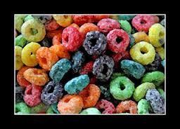
Loops

Slide 203
for .. do .. done
for name in words
do
commands
done
for (( expr1 ; expr2 ; expr3 ))
do
commands
done

Slide 204
Loops - for
for is used to step through multiple words
for i in apple pear fig ; do echo $i ; done
apple
pear
fig

Slide 205
Loops - for
With brace expansion:
for i in {1..5}; do echo $i ; done
1
2
3
4
5

Slide 206
Loops - for
With arrays
array=(moe larry curly)
for i in "${array[@]}" ; do echo $i ; done
moe
larry
curly

Slide 207
Walk Through Directories
Find all files in /home and count how many lines are in each file:
for file in $(ls -a ~/); do
[[ -f ~/$file ]] && wc -l ~/$file
done
2 .bash_logout
12 .bash_profile
8 .bashrc
20 .emacs
11 .kshrc
34 .zshrc

Slide 208
C-style for loop
for can be used for integer traversal
for (( i=1 ; i < 1000 ; i=i+i ))
do
echo $i
done
1
2
4
8
16
32
64
128
256
512

Slide 209
while .. do .. done
while test-commands
do
consequent-commands
done

Slide 210
until .. do .. done
until test-commands
do
consequent-commands
done

Slide 211
Loops - until
Until uses test commands
Handy with math
Can be used with semaphore files
a=0
until [[ $a -gt 10 ]] ; do echo $a ; ((a=a+3)) ; done
0
3
6
9
$ until [[ -e stop.file ]] ; do sleep 60 ; done

Slide 212
Loops - while
while is the reverse of until
a=1
while [[ $a -le 5 ]] ; do echo $a ; ((a++)) ; done
1
2
3
4
5

Slide 213
continue
Can be used to skip to next element
for a in {1..5}; do
if [[ $a == 2 ]]; then
continue;
fi
echo $a
done
1
3
4
5

Slide 214
break
Can be used to end loops or skip sections
a=1
while [[ 1 ]] ; do
echo $a
if (( a > $(date +%s) )) ; then
break
fi
(( a=a+a ))
done
1
2
4
…
2147483648

Slide 215
examples/loops/stepping.sh
iterations=5
iterations_remaining=$iterations
seconds_per_step=2
while (( $iterations_remaining > 0 ))
do
if (( ($(date +%s) % $seconds_per_step) == 0 ))
then
echo -n "$iterations_remaining : "
( date ; sleep 10 ) &
((iterations_remaining--))
fi
sleep 1
done

Slide 216
examples/loops/genome_nonsense.sh
#!/bin/bash
BASE=gn.$RANDOM
for i in {1..22} X Y M ; do
label=$i
if [[ $i == [[:digit:]] ]]; then
label=$(printf '%02d' $i)
fi
[[ -f $BASE/$label/trial.out ]] && break
[[ -d $BASE/$label ]] || mkdir -p $BASE/$label
pushd $BASE/$label 2>&1 > /dev/null
echo Running chr${i}_out
# actually do something, not this
touch trial_chr${i}.out
popd >& /dev/null
done

Slide 217

ACCESSORIZE

Slide 218
Interactive Script Input
use the read command to interactively get a line of input:
echo -n "Type in a number: "
read response
echo "You said: $response"
$ bash script.sh
Type in a number: 4
You said: 4
$

Slide 219
Using while and read in a script
examples/loops/readfile.sh
while read var
do
if [[ $var == "exit" ]]
then
break
fi
echo $var
# do something else with $var
done

Slide 220
Walk a file with read
examples/loops/repeat_file.sh
#!/bin/bash
while IFS='' read -r line || [[ -n "$line" ]]; do
echo "Text read from file: $line"
done < "$1"
bash examples/loops/repeat_file.sh input/loop_input.txt
Text read from file: These are fruits:
Text read from file:
Text read from file: apple
Text read from file: pear
Text read from file: fig
Text read from file: banana

Slide 221
examples/options/basic.sh
mem="1g"
tmpdir="/tmp"
usage="$0 [-m] [-t] [-h]
-m mem (default 1g)
-t tmpdir (default /tmp)
-h show this help menu"
while getopts "m:t:h" flag; do
case "$flag" in
m) mem=$OPTARG ;;
t) tmpdir=$OPTARG ;;
h) echo "$usage" ; exit 0 ;;
?) echo "$usage" ; exit 1 ;;
esac
done

Slide 222
examples/options/select.sh
#!/bin/bash
echo "Pick a fruit, any fruit"
select fname in apple pear fig plum pineapple orange
do
break
done
echo "You picked $fname"
$ ./select.sh
Pick a fruit, any fruit
1) apple 3) fig 5) pineapple
2) pear 4) plum 6) orange
#? 4
You picked plum

Slide 223
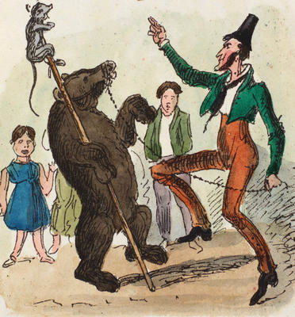
Stupid pet tricks

Slide 224
Extended Math
Use bc instead:
Might as well use perl or python instead…
number=$(echo "scale=4; 17/7" | bc)
echo $number
2.4285
x=8
y=3
z=$(echo "scale = 3; $x/$y" | bc)
echo $z
2.666

Slide 225
Fun with substring expansion
$ string=01234567890abcdefgh
$ echo ${string:7}
7890abcdefgh
$ echo ${string:7:0}
$ echo ${string:7:2}
78
$ echo ${string:7:-2}
7890abcdef
$ echo ${string: -7}
bcdefgh
$ echo ${string: -7:0}
$ echo ${string: -7:2}
bc
$ echo ${string: -7:-2}
bcdef

Slide 226
Substring expansion with arrays
$ array=(0 1 2 3 4 5 6 7 8 9 0 a b c d e f g h)
$ echo ${array[@]:7}
7 8 9 0 a b c d e f g h
$ echo ${array[@]:7:2}
7 8
$ echo ${array[@]: -7:2}
b c
$ echo ${array[@]: -7:-2}
bash: -2: substring expression < 0
$ echo ${array[@]:0}
0 1 2 3 4 5 6 7 8 9 0 a b c d e f g h
$ echo ${array[@]:0:2}
0 1
$ echo ${array[@]: -7:0}

Slide 227
Parse fasta file
$ cat zz.fasta
>gi|bogus
abcde
>gi|nonsense
xyz123
>gi|something else
ABCDEF123
$ while read -d '>' block ; do array[${#array[@]}]="$block" ; done < <(cat zz.fasta <(echo '>') )
# This sets the zeroth element as blank. Use this command to remove the zeroth element
$ array=("${array[@]:1}")

Slide 228
grep
Find only that which matched
Recursive search
Use a list of matches from a file
ls -l /home | grep -o "Dec .[[:digit:]] ..:.."
grep -R -l bash *
grep -f examples/grep/complex.grep –h examples/matching/*

Slide 229
egrep
Extended grep allows additional metacharacters like +, ?, |, {} and ()
{} match number of times
egrep 'ftp/phase3/data/[^\/]+/exome_alignment/[^\/]+\.mapped\.ILLUMINA\.bwa\.[^\/]+\.exome\.[^\/]+\.bam' /fdb/1000genomes/ftp/current.tree
ls -l /home | egrep --color ' [0-9]{7} [[:alpha:]]{3} [0-9]{2}'
Notes:
The first example is for matching a particular type of bam file in the 1000genomes repo. The second example finds /home directories which have (or had at some point) a ridiculous number of files.

Slide 230
find
Find large files
Find recently modified files
find . -type f -size +1M
find ~ -mmin -100

Slide 231
find
Find and update files and directories in a shared directory
$ find . -user [you] ! -group [grp]
$ find . -user [you] ! -group [grp] -exec chgrp [yourgroup] {} \;
$ find . -user [you] -perm /u+r ! -perm /g+r
$ find . -user [you] -perm /u+r ! -perm /g+r -exec chmod g+r {} \;
$ find . -user [you] -perm /u+x ! -perm /g+x
$ find . -user [you] -perm /u+x ! -perm /g+x -exec chmod g+x {} \;

Slide 232
find
Find newest and oldest files in a directory tree
Find biggest and smallest files
Find empty directories
find . -type f -printf '%Tc %p\n' | sort -nr | head
find . -type f -printf '%Tc %p\n' | sort -nr | tail
find . -type f -printf '%k %p\n' | sort -nr | head
find . -type f -printf '%k %p\n' | sort -nr | tail
find . -type d -empty -printf "%Tc %p\n"

Slide 233
sort
input/file_for_sorting.txt
Sort by alternative column (key)
Multi-column sort
sort input/file_for_sorting.txt
sort -k1 input/file_for_sorting.txt
sort -k3 -k1 -k4 input/file_for_sorting.txt

Slide 234
sort
Sort file, locking top line
Sort as recognized data type
cat input/file_for_sorting.txt | (read -r; \
printf "%s\n" "$REPLY"; sort -k3 -k1 -k4)
cat input/file_for_sorting.txt | (read -r; \
printf "%s\n" "$REPLY"; sort -k1M -k2n -k3r)

Slide 235
sort
Deal with missing values
Sort very large file with memory limit
man sort
cat input/file_for_sorting.txt | (read -r; \
printf "%s\n" "$REPLY"; sort -t $'\t' -k6h)
sort /fdb/annovar/current/hg19/hg19_ljb26_cadd.txt -n -k6 -S 25%

Slide 236
Spaces in file names
Replace newline with null character
Use IFS= and double quotes
for i in $(ls -1) ; do
wc -l $i
done
find . -type f -print0 | xargs -0 wc -l
while IFS= read -r line; do
du -hs "$line"
done < <(ls -1)

Slide 237
Tab delimited files
Rearrange order of columns using awk
Rearrange order using while … read
awk 'BEGIN { FS = "\t" } ; {print $3FS$2FS$1}' \
input/file_for_sorting.txt
while IFS=$'\t' read -r field1 field2 field3 others
do
echo ${field2}$'\t'${field3}$'\t'${field1}
done < input/file_for_sorting.txt

Slide 238
Use of IFS
Parse string into words
IFS=: p=($PATH)
for i in ${p[@]}; do echo $i ; done
/usr/bin
/bin
/usr/local/bin
/home/user/bin

Slide 239
complete
Tab-complete possible arguments
function do_something { echo You picked $1; }
array=(pineapple apple pear fig banana)
complete -W "${array[*]}" do_something
$ do_something <tab><tab>
apple banana fig pear pineapple
$ do_something a<tab><tab>
apple
$ do_something p<tab><tab>
pear pineapple

Slide 240
complete
Specify file type allowed
man complete
complete -f -X '!*.tsv' do_something
$ do_something input/<tab><tab>
database.tsv exp1.tsv exp2.tsv exp3.tsv final.tsv

Slide 241
hash
Similar to history table
Hard-code executable paths outside of $PATH
Keep a count of executable calls
The hash table is NOT propagated to subshells
$ hash
$ hash -l
$ hash -p /path/to/command name
$ hash -d name
$ hash -r

Slide 242
readarray
Read a file into an array
$ cat file_to_be_mapped.txt
This is line one
The second line
Finally line 3
$ readarray zzz < file_to_be_mapped.txt
$ echo ${zzz[1]}
The second line

Slide 243
Sort elements of an array
Use xargs
Unique sorted elements
array=(apple pear fig plum pineapple orange)
echo ${array[@]} | xargs -n 1 | sort | xargs
apple fig orange pear pineapple plum
array=(3 0 4 7 0 8 4 5 9 6 3 1 9 0 2 3 4)
echo ${array[@]} | xargs -n 1 | sort -u | xargs
0 1 2 3 4 5 6 7 8 9

Slide 244
Other uses for xargs
Print wc output neatly
Operate on contents of a file
find . -type f -print0 | xargs -0 wc
apple
pear
fig
orange
$ xargs -a fruits mkdir
$ ls -F
apple/ fig/ fruits orange/ pear/

Slide 245
awk and sed
awk is a scripting language
sed is a file/stream manipulation language
awk '{sum += $2} END {print sum/NR}' \
input/file_for_sorting.txt
sed 's/Feb/February/g' input/file_for_sorting.txt
sed -n '5,8p' input/file_for_sorting.txt

Slide 246
Funny Characters
Windows text editors will add carriage returns
Certain text editors may insert unicode characters
file input/notepad.txt
notepad.txt: ASCII text, with CRLF line terminators
file input/unicode.txt
unicode.txt: UTF-8 Unicode text

Slide 247
Funny Characters
You can find non-printing characters using sed and grep:
sed 's/\r/\xFF/g' input/notepad.txt
1:This is a test file�
2:created using Notepad�
3:on a Windows machine.�
4:�

Slide 248
Funny Characters
Unicode:
Even tabs:
LANG=C grep -n --color=always \
'[^[:cntrl:] -~]\+' input/unicode.txt
1:This is a file that contains unicode characters '소녀시대' That snuck in somehow
sed 's/\t/\xe2\x9e\xa4/g' input/tab_delimit.txt | \
grep --color=auto -P -n "[^\x00-\x7F]"
1:This➤file➤has➤tab delimited➤fields➤for➤searching

Slide 249
highlightTabs, highlightUnicode
$ highlightTabs.sh examples/funny_characters/tab_delimit.txt
1:This➤file➤has➤tab delimited➤fields➤for➤searching
$ highlightUnicode.sh examples/funny_characters/unicode.txt
1:This is a file that contains unicode characters '소녀시대' That snuck in somehow
2:Strange space character: [ ] em space U+2003
4:Another funny character '█'

Slide 250
screen and tmux
Allows login sessions to be saved, detached, and reattached
Cryptic controls with [CTRL-a]
tmux is a little more sophisticated, and is not immediately available
$ screen
$ ml tmux
$ tmux

Slide 251

Extras

Slide 252
Expanded List of Linux Commands
a2p | chmod | dos2unix | getopts | lftp | openssl | readlink | sort | tree | wc
a2ps | chown | du | ghostscript | lftpget | passwd | readonly | source | true | wget
acroread | chsh | echo | glxinfo | ln | paste | rename | split | tset | whatis
alias | cksum | egrep | gpg | local | patch | renice | splitdiff | type | whereis
apropos | clear | emacs | grep | locate | pathchk | reset | sqlite3 | ulimit | which
at | cmp | enable | groups | lockfile | pdf2ps | resize | ssh | umask | whiptail
awk | column | enscript | gs | login | perl | return | stat | unalias | who
basename | combinediff | env | gunzip | logname | pgrep | rev | strace | uname | whoami
bash | comm | eval | gvim | logout | php | rexec | stream | unexpand | whois
batch | continue | exec | gvimdiff | look | pico | rlogin | strings | uniq | xargs
batchlim | cp | exit | gzip | ls | pidof | rm | submitinfo | unix2dos | xclock
bc | crontab | expand | hash | lsof | ping | rmdir | suspend | unlink | xdiff
bg | csh | export | head | mac2unix | pinky | rsh | svn | unset | xeyes
bind | csplit | expr | help | man | pkill | rsync | swarm | unzip | xterm
break | curl | factor | history | man2html | popd | scp | swarmdel | updatedb | yes
bunzip2 | cut | false | host | md5sum | pr | screen | tac | uptime | zcat
bzcat | cvs | fg | hostname | merge | printenv | script | tail | urlview | zcmp
bzcmp | date | fgrep | iconv | mkdir | printf | sdiff | tailf | users | zdiff
bzdiff | dc | file | id | mkfifo | ps | sed | tar | usleep | zforce
bzgrep | dd | find | info | more | pushd | sendmail | tcsh | vdir | zgrep
bzip2 | declare | finger | interdiff | mv | pwd | seq | tee | vi | zip
bzip2recover | df | flock | iostat | namei | python | set | telnet | view | zipgrep
bzless | diff | fmt | jobcheck | nano | qdel | setsid | test | vim | zipinfo
bzmore | diff3 | fold | jobload | netstat | qselect | sftp | time | vimdiff | zipnote
cal | dir | free | jobs | newer | qstat | sg | timeout3 | vimtutor | zipsplit
cat | dircolors | freen | join | newgrp | qsub | sh | times | vmstat | zless
cd | dirname | ftp | kill | nice | quota | shift | top | zmore | zsh
checkquota | dirs | funzip | ksh | nl | rcp | shopt | touch | wait
chfn | disown | gawk | less | nohup | rdist | shred | tr | wall
chgrp | display | gedit | let | oclock | read | sleep | trap | watch

Slide 253
Definitions
Character: result of a keystroke
Metacharacter: separates words
Blank: space, tab, or newline
character
metacharacter
| & ; ( ) < > [ ] blank
blank

Slide 254
Definitions
Token: one or more characters separated into fields
Word: a token with no unquoted metacharacters
Operator: a token with one or more metacharacters
token
word
operator

Slide 255
Definitions
Name: a word with [a..z,A..Z,0..9,_] only
Control operator: performs control functions
Redirection operator: redirects file descriptors
Filename: identifies a file
Reserved word: special meaning , like for or while
token
word
operator
name
control operator
|| && & ; ;; | |& ( ) newline
redirection operator
< << >> >
>& <> <&
filename
reserved word

Slide 256
Definitions
Parameter: stores values
Variable: name for storing values, must begin with letter
Special parameter: can’t be modified
Positional parameters: for retrieving arguments
token
word
operator
name
control operator
|| && & ; ;; | |& ( ) newline
function/alias
parameter
variable
redirection operator
< << >> >
>& <> <&
special parameter
positional parameter
filename
reserved word

Slide 257
Shell Parameters - Special
Special parameters have a single character
$* expands to the positional parameters
$@ the same as $*, but as array rather than string
$# number of positional parameters
$- current option flags when shell invoked
$$ process id of the shell
$! process id of last executed background command
$0 name of the shell or shell script
$_ final argument of last executed foreground command
$? exit status of last executed foreground command

Slide 258
Bash Variables SET
$BASH_REMATCH
$BASH_SUBSHELL
$PWD
$REPLY
$SHLVL
… type man bash, search for Shell Variables

Slide 259
Bash Variables USED
$BASH_ENV
$HISTFILE
$HISTFILESIZE
$IFS
$PATH
… type man bash, search for Shell Variables

Slide 260

Questions? Comments?
staff@hpc.nih.gov

